Slide 1
BCT Staff Planning TTPs
Leader Training Program
Version 37
As of 7 December 2020

Slide 2
Table of Contents
Section I: Hot Topics p.2
Cdr’s Initial Guidance Template p. 2a-2b
Fighting Products Defined p. 3
Examples of Fighting Products p.4-14
(Execution Matrix, SYNCHMAT, DSM, EXCHECK, TSM, Event Template, Information Collection Synch Matrix)
XO, S3, Ops SGM Roles MDMP Responsibilities p.15
Further Defining the Brigade Fights p. 15a – 15b
HOPE Timeline Defined p.16
HOPE Timeline Example p. 17-18
Section II: MDMP Steps
- Step 1 Receipt of Mission p. 19
Step 1: Receipt of Mission (Framing the Problem) p.20
Framing the Problem Huddle Agenda p. 21
BEB & BSB Collaborative Planning TTP p. 22
Building the Operational Framework p. 23
- Step 2 Mission Analysis p. 24
BCT Mission Analysis Brief “A Way” p. 25
CCIR Matrix TTP p. 26
Staff Estimate MA Slide Recommendation p. 27
Mission Analysis on Mech & Aviation Forces p. 28-29
Enemy Vulnerabilities Matrix p. 30
Information Collection Planning (Things to Consider) p. 31
Information Collection Meeting #1 p.32
Information Collection Meeting #2 p. 33
Initial Targeting Huddle p. 34
Running Estimates p. 35
Example Staff Estimates Quad Charts p. 36
Reverse War Fighting Function Worksheets p.37-38
Reverse War Fighting Function Huddle p.39
Information Operations (IO) Mission Analysis Chart p.40-43
Step 3 COA Development p. 44
Enemy Vulnerabilities Review p. 45
COA Development Steps p. 46a – 57a
AGADAD Smart Card “Cut Outs” p. 58-59
Building Combat Power Trends p. 60
Command & Control of Building Combat Power TTP p. 61
Building Tactical Convoy Priority Vehicle List (PVL) p. 62
Building Combat Power Sketch (Blow Up) p. 63
Examples of Priority Vehicle List (PVL) p. 64
Step 4 COA Analysis (War Gaming) p. 65
War Gaming Trends p. 66
Gather the Tools “Checklist by WfF” p.66a
Example Synch Matrix by WfF p. 67-68
War Gaming Tools: Synch Cards p.69
War Gaming Room Set Up p. 71
The War Game Process / Sequence of Events p. 72
How do you Synch events you don’t have time to war game p. 73
Enemy Vulnerabilities Matrix during War Gaming p. 74
War Gaming Battle Causality Estimate TTP p. 75
Step 5 COA Comparison p. 76
Step 6 COA Approval p. 78
Step 7 Order Production p. 79-80
Section: III: Rehearsals: p.81
Developing the Plan for the BCT Rehearsal (CAR) p. 82
Example Combined Arms Rehearsal Agenda p. 83-84
Fires & Intel Rehearsal p.85
Mission Command Rehearsal Agenda p.86
Sustainment Rehearsal Agenda p.87
Section IV: Other TTPs p.88
LNO Duties and Responsibilities p. 89
BCT HPT Strike Battle Drill p. 90
MDMP Fires Inputs – Outputs p. 91
Network Transition from Analog to Digital p. 92
Army Support & Command Relationships p. 93-94
Section V: Air Assault Planning p. 95
Air Assault Planning Stages & BCT Staff Responsibilities
Air Assault Trends p. 97
Air Assault Planning Considerations p.98
Air Assault Abort Criteria Matrix p. 99
p.96
1

Slide 3
Section 1: Hot Topics
2

Slide 4
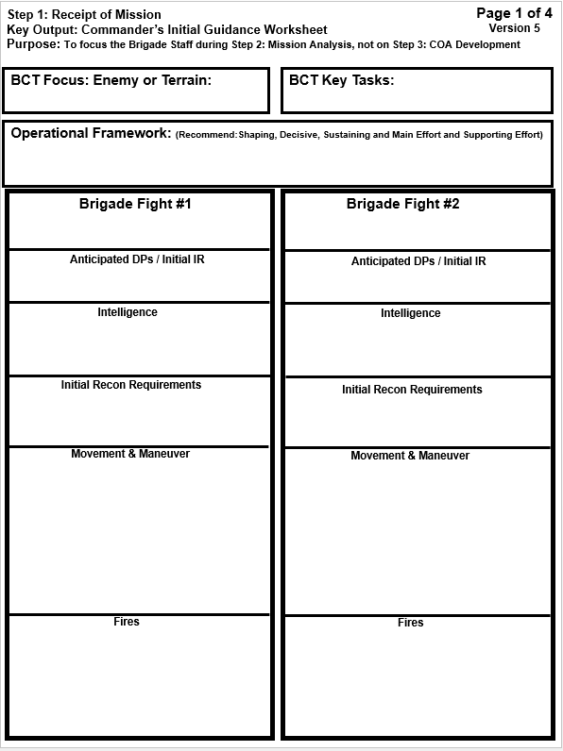
Step 1: Receipt of Mission: Commander’s Initial Guidance Worksheet: “A Way”
Trend #1: Cdr’s try to use their “Planning Guidance” Worksheet as a replacement for their “Initial Guidance” worksheet.
The Planning Guidance worksheet is too in-depth!
Trend #2: Cdr’s don’t understand their initial guidance should help “focus” their staff while they are conducting mission analysis and deciding what to present to the Cdr during the MA Brief. Tell them specifically what you want to know!
Example: Instead of conducting IPB on the entire BCT AO, focus them on the main MSRs and cross over routes.
The staff members do not need for Commanders to write a mission statement this early in the process. Tell the staff if you think we are “enemy” focused or “terrain” focused.
Trend #3: Cdr’s do not “package” their guidance in line with their brigade fights.
You should be able to walk each specific piece of guidance back to one of your Brigade Fights.
Cdr guidance: I want to know about all the EN obstacles along both MSRs.
Cdr Question: What EN IADA & FS Systems does he have in our AO?
Cdr Question: What is Division
doing for the BCT with fires?
2a

Slide 5
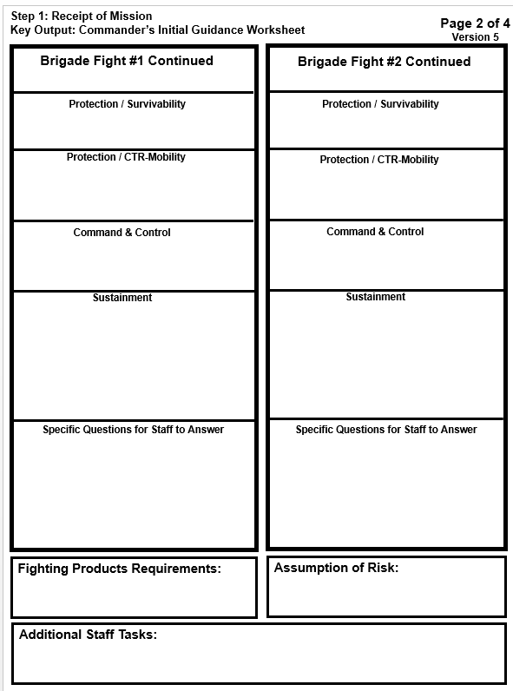
Cdr Question: What breaching capabilities does the Mech Force have avaibale?
Cdr Question: Do we have enough organic breaching assets to get through all the EN templated obstacles along both MSRs?
Trend #4: Staffs almost never conduct analysis on the two assets that will challenge them the most on fuel and ammo…tanks & aviation!
Cdr Question: Can the tanks get from our current TAA location to our furthest Western OBJs on one tank of gas?
Trend #5: Cdr’s do not inform the staff on what they want for fighting products or what format they want their staff to use for each one.
2b

Slide 6
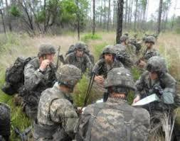
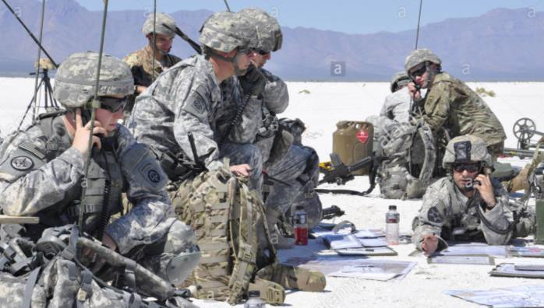
Fighting Products
* Non-doctrinal Term
What are fighting products: Quick reference written and visual tools, produced during the planning for an operation that capture and summarize key information from the OPORD. Used by commanders, key leaders, and staff members to assist in decision-making and for managing the execution and assessment of a specific course of action to accomplish the unit’s mission.
Examples of fighting products (not all inclusive):
Execution Matrix
Decision Support Matrix (DSM)
Target Synchronization Matrix (TSM)
Event Template
Information Collection Synch Matrix
High Payoff Target List (HPTL)
Operations Graphics
EXCHECK
SYNCHMAT
Fires EXCHECK
Trends from LTP Coaches:
Commanders have not described to their staffs what their specific fighting products are and how they want them to look.
Operational Graphics are the most over-looked fighting product and the least developed.
Staffs have not assigned ownership of each fighting product to a war fighting lead in their PSOP.
Staffs wait until MDMP Step 7:Orders Production to produce their specific fighting products, which is too late in the
process.
Staffs do not continuously build their specific fighting product throughout each step of the MDMP process.
Staffs do not validate their fighting products during step 4: COA Analysis (War Gaming)
Staffs often call their War Gaming Synch Matrix a fighting product. However, what they actually mean is a Synch Matrix with key topics pulled from their war gaming synch matrix.
3

Slide 7
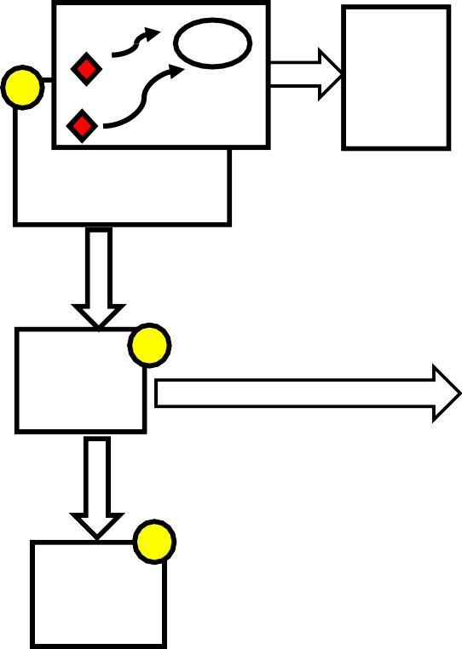
Developing Fighting Products
.v4
Understand
Visualize
Describe
Direct
Step 1 Step 2
Step 3 Step 4 Step 5 Step 6
Step 7
Receipt Of Mission
Mission Analysis
COA
Development
COA
Analysis
(War Gaming)
COA
Comparison
COA
Approval
Orders
Production
Out Puts
Out Puts
Out Puts
Out Puts
Commander’s Directed
“Fighting Products”
SITEMP
5
7
OBJ
High Value TGT
List
High
SYNCH Matrix
90% Complete
100% Complete
1
FEEDS
FEEDS
Payoff
TGT
List
80%
Complete
EVENTEMP
Initial CCIR
IC SYNCHMAT
DST
HPTL
TGT SYNCHMAT
SYNCHMAT
GRAPHICS
80% Complete
EVENT TEMPLATE
80% Complete
F E E D S
8
F
Graphics ^{E} 75%
95% Complete
100% Complete
E D
4
S
Initial CCIR
2
Decision Support Template
FEEDS
90% Complete
95% Complete
100% Complete
50% Complete
50% Complete
F E E D S
3
Targeting ⁶
90% Complete
100% Complete
Initial
Synch Matrix
Collection Synch Matrix
20% Complete
80% Complete
90% Complete
100% Complete
4

Slide 8
5
8

Slide 9
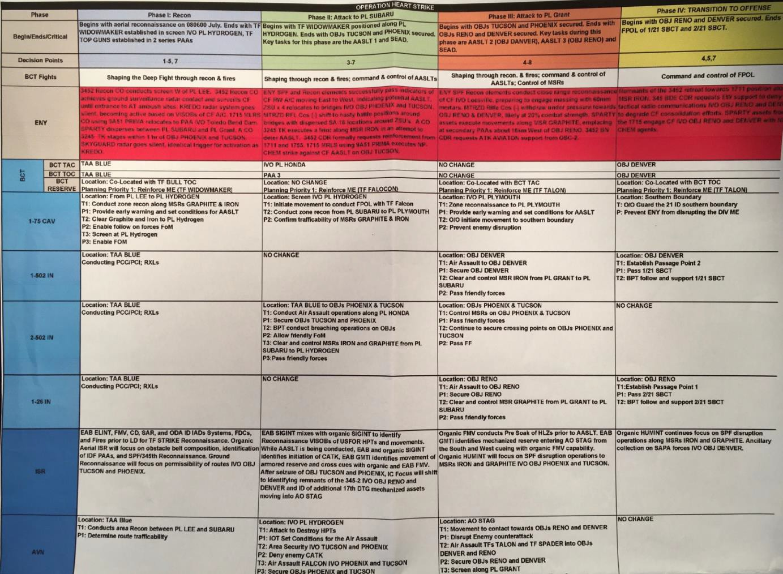
Execution Matrix TTP
Example does not show all the remaining WfF listed below with their key tasks
6

Slide 10
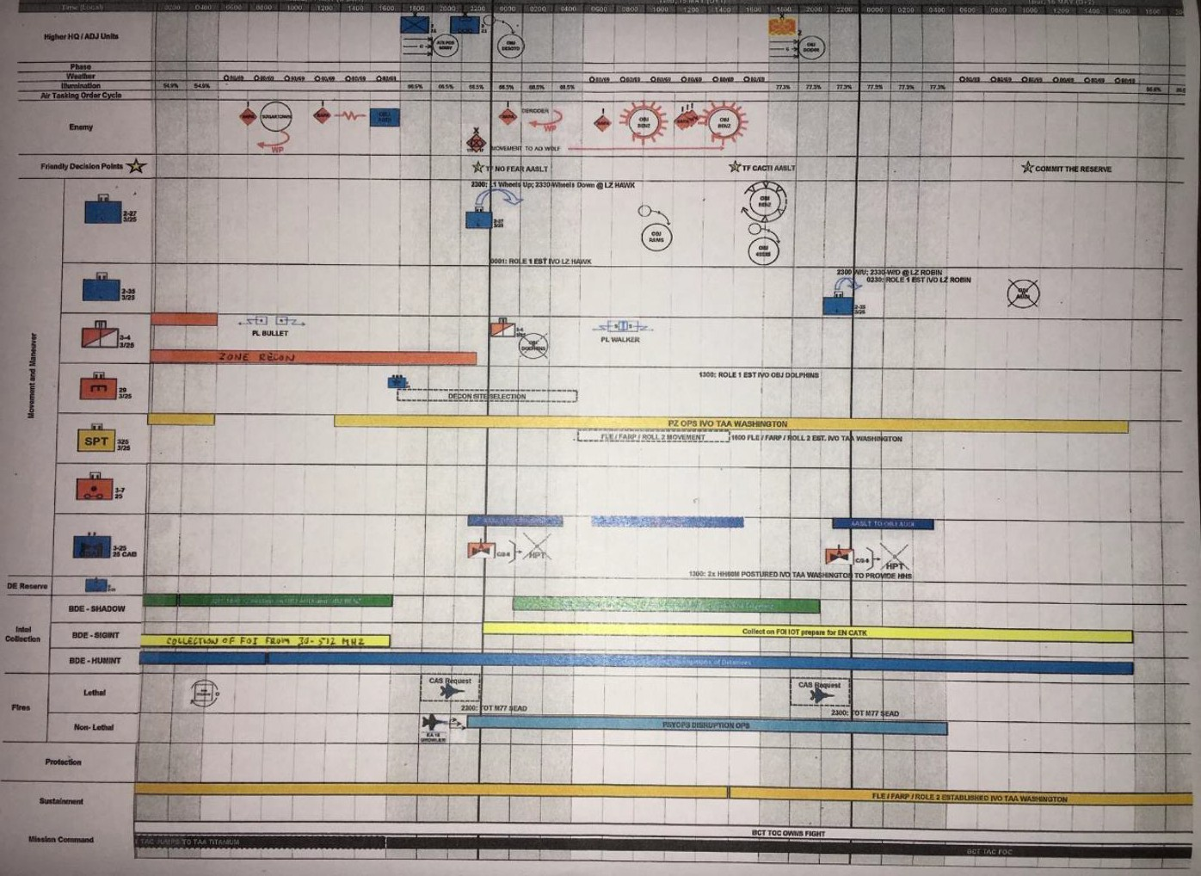
Fighting Synch Matrix TTP
7

Slide 11
Fighting Synch Matrix TTP
8
11

Slide 12
Decision Support Matrix (A Way)
9

Slide 13
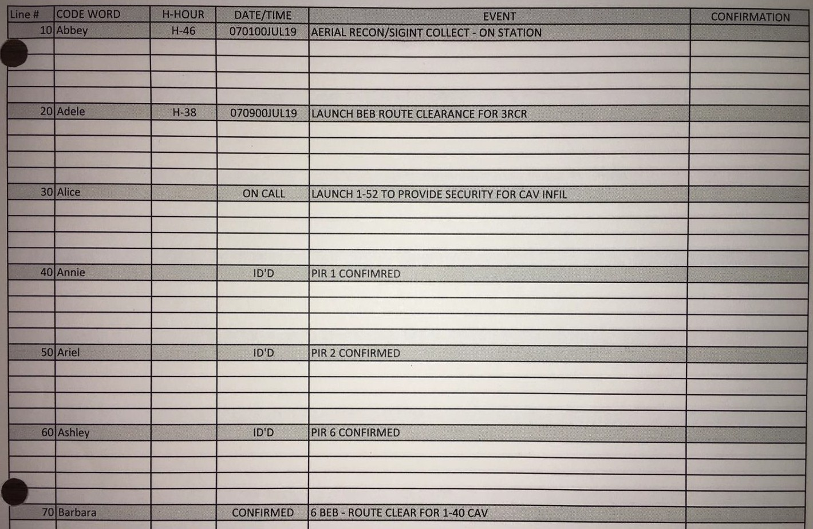
EXCHECK (A Way)
10

Slide 14
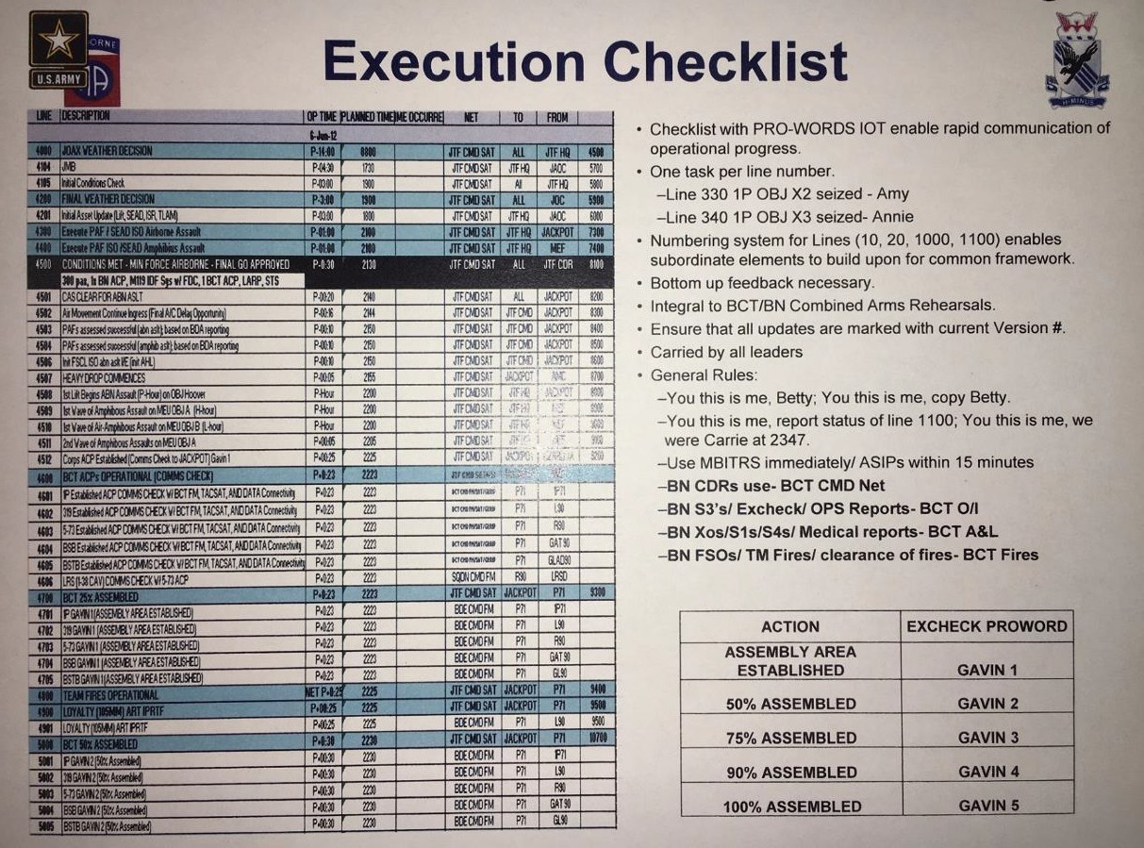
11

Slide 15
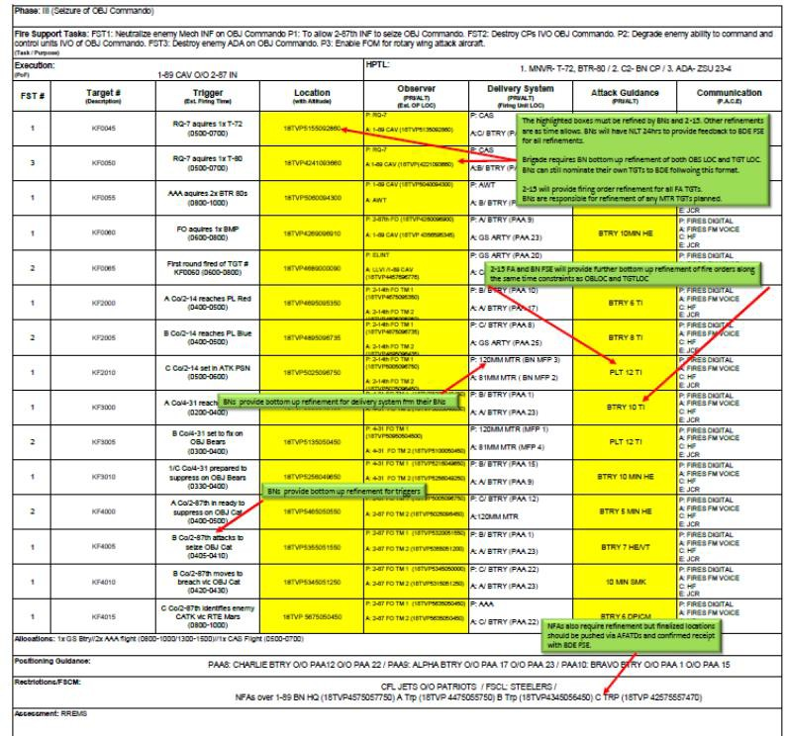
Target Synchronization Matrix: TSM (A Way)
12

Slide 16
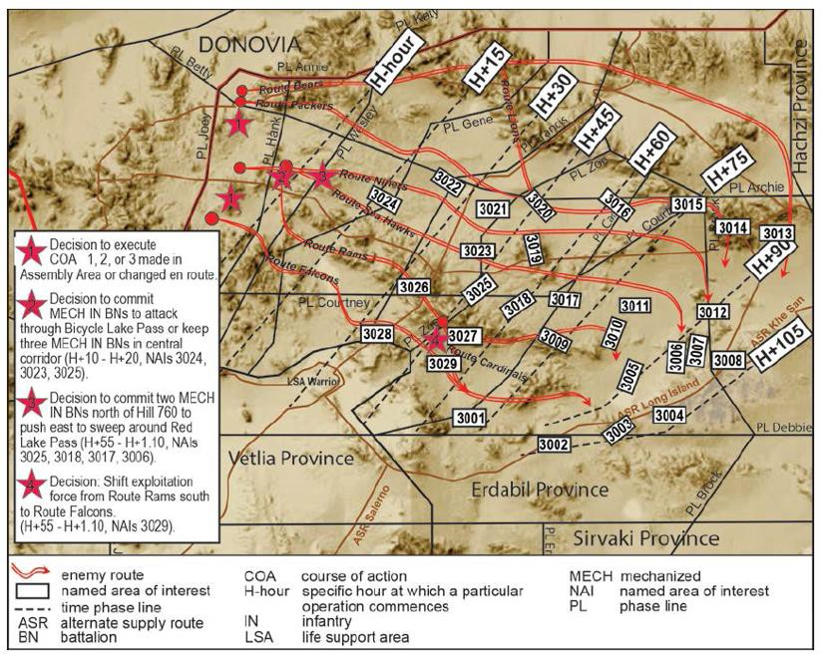
Event Template: (A Way)
13

Slide 17
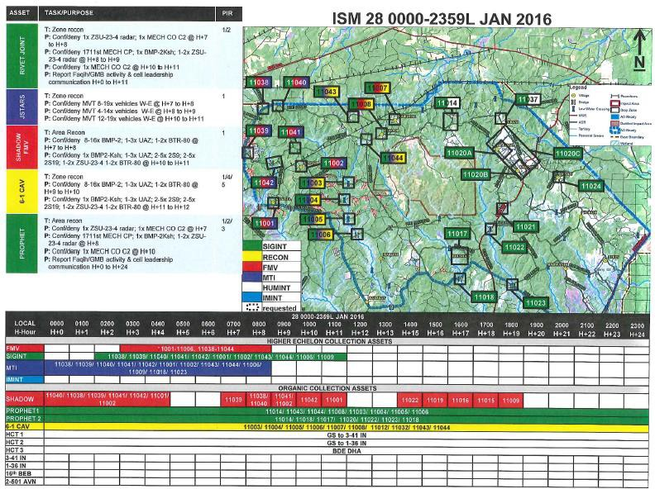
Information Collection Synchronization Matrix: (A Way)
ICSM
14

Slide 18
XO / S3 / SGM MDMP Responsibilities: TTP
MDMP Step | XO | S3 | SGM
Receipt of Mission | Reads Higher HQs Order Assigns analysis of Higher HQs order to staff Creates Planning Timeline Issues CDR’s MA Worksheet Issues Planning Guidance Approves WARNO 1 | Reads Higher HQs Order Directs responsibilities of the S3 Shop in MDMP S3 Shop develops WARNO 1 Edits WARNO 1 | Reads Higher HQs Order Assembles & Prepares Staff for Mission Analysis Develops Planning Timeline Supervise Staff WARNO 1 review Supervise WARNO 1 distro
Mission Analysis | Directs MA Product Rqts Enforces MDMP timeline & staff interaction Updates MDMP Timeline; approves draft of HOPE timeline Develops Risk Estimate Develops Evaluation Criteria Supervises Analysis Quality, Applicability Seeks CDR approval of min. req’d OPORD products | Develops Problem & Mission Statement, Cdr’s Intent W/2 & FSO develops CCIR, EEFIs Review Estimates to determine ME tasks, assumptions, constraints Coordinates with Adjacent Units Approves WARNO 2 Conducts ICM | Identifies WFF personnel gaps, takes action to fill Directs setup for MA Brief Review WARNO 2 Supervise WARNO 2 distro. Gathers COA Development Tools Recommends Sync Matrix Events to S3 for Approval and to begin building matrix
COA Development | Directs COA Dev. Standards and time Ensures consistency in COA Dev efforts Enforces RFI process/Reviews RFIs | Develops Restated Mission from Cdr’s MA Guidance Leads COA Dev Tm 1; S2 leads COA Dev Tm 2 Reviews each COA for completeness | On-boards Attachments Gathers Wargaming Tools Assigns Responsibilities BPT to lead a COA Development Team
4. COA Analysis/ Wargaming | Approves Setup Explains process to staff Directs the Wargaming process Enforces RFI process/Reviews RFIs | Talks Scheme of Maneuver Directs actions of WFFs Directs need for refinements, GCMs, branches and sequels | Disciplines the Wargaming process to capture changes, and simultaneously build order
5. COA Comparison | Applies Evaluation Criteria w/staff to Eval COAs Develops Recommended COA w/S3, SGM Reviews Estimate Updates Reviews Assumptions Reviews RFIs | Applies Evaluation Criteria w/staff to Eval COAs Reviews COA Schemes of Maneuver Reads, edits, pubs WARNO 3 | Applies Evaluation Criteria w/staff to Eval COAs Supervise Staff Review of WARNO 3 Supervise WARNO 3 distro. Prepares setup for COA approval Brief
6. COA Approval | Directs COA Approval Brief agenda Directs COA Approval Brief | Leads COA Approval Brief Refines DSM Refines COA for completeness Refines Intent Refines Mission Command Plan | Reviews COA Refinements Confirms Units know DTG and location of OPORD Confirms Units know Confirmation and Back- brief requirements
7. Orders Production/ Dissemination/ Transition | Directs Orders Production Completes Risk Management Plan Approves HOPE Timeline updates Approves OPORD for distro Chairs Confirmation Brief Chairs Back-brief Chairs BCT CAR Attends MC RHXL | Recommends RHXL Vignettes to CDR Completes Graphics Completes/Reviews OPORD, Annexes, Graphics, & TO Reviews HOPE Timeline Approves RHXL FRAGO Participates MC RHXL Leads BCT CAR Documents changes to plan from CAR results Approves FRAGO 1 from CAR results | Supervises Orders Production Updates HOPE Timeline Review OPORD, Annexes, Graphics, & TO Supervise OPORD and Graphics distro Directs & Supervises CAR Terrain Model setup Publish RHXL FRAGO Attends BCT CAR Develops FRAGO 1 from CAR results 15

Slide 19
Brigade Fights
Non-Doctrinal Term: Brigade Fights
- Brigade fights are events or time periods identified by the commander that require brigade level planning, prioritization of resources, synchronization, and command and control. During planning, early identification of brigade fights prioritizes planning effort and allows the staff to better manage limited planning time.
Vignette:
Step 1: Receipt of Mission (Initial Guidance)
Commander to the BCT Staff:
- “21st Division HQs directed we conduct a 2 x Battalion Air Assault. Therefore, C2 of the Air Assault is one of my Brigade Fights.”
The XO and S3 need to further break down this brigade fight to allow the staff to visualize and understand all the subcomponent tasks involved in order to get from a conceptual plan to detailed plan.
XO / S3 to the Staff:
“This is how we are going to further break this brigade fight, C2 of the Air Assault down even further so we can get to detailed planning. We need to plan the following:”
IC plan for Enemy Integrated Air Defense Systems - Reconnaissance of HLZ (Prim & Alt)
Insert C Troop - SEAD Internal & Coord w/ Div - Who makes the Cherry / Ice Call at the HLZ
Comms Plan between Avn, TAC, TOC
PZ A/C Bump Plan - SOF / INDIG Integration
Fighting Product: EXCHECK (A/S3)
- C2 Platform - PZ Control (Hvy & Lt PZs)
- CASEVAC (back haul to PZ, then PZ to Role 3)
The XO and S3 need to break all the Brigade Fights down to this level of detail in order to get the staff to detailed planning. They cannot get there on their own!
15a

Slide 20
Further Defining the BCT Fights
Step 1: Receipt of Mission Commander’s
Initial Guidance
Air Assault
Ground Mvtment Control
Trend 1:
Commander’s are hesitant to identify their Brigade Fights
this early in the process for the fear of being wrong.
Sustainment
Shaping Fires
Recon
The XO/S2/S3/FSO should huddle often to answer at a minimum the following questions for the staff!
Trend 2:
The XO/S2/S3/FSO never further define the Brigade Fights for the staff and leave it to them to
figure out these five questions on their own.
1 Determine if the BCT Fight is “Enduring” or “Discrete.”
Step 2: Mission Anlaysis
2 Synch each BCT Fight with the Enemy Timeline.
3 Identify “when” each BCT Fight will occur on the Ops Timeline.
Step 3: COA Development
4
Identify “where” each BCT Fight will occur on the map.
5 Determine how each WfF will Resource the BCT Fight.
Trend 3:
Staffs are still trying to figure out these five basic questions for each Brigade Fight during the war-gaming step or they never get there.
End Goal: You are trying to pull out the golden nuggets from the initial clump of dirt in order to help focus the staff!
Air
Assault
Ground Mvtment
Control
Sustainment
Shaping Fires
Recon
By answering the five questions it provides clarity for the staff to properly plan in detail!
15b

Slide 21
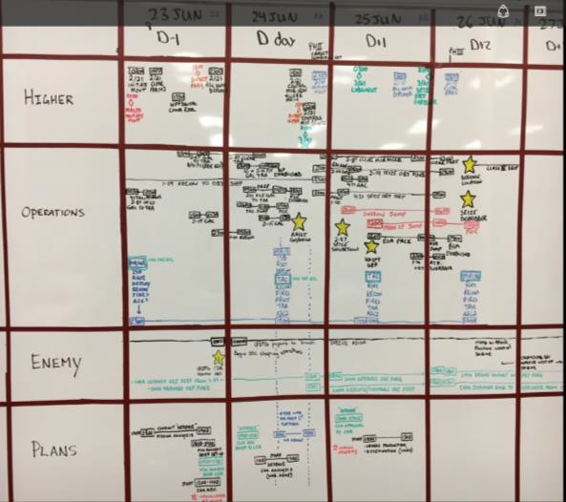
HOPE Timeline “TTP”
Purpose: The HOPE timeline is a planning tool that assists the staff to synchronize the unit’s battle rhythm events with a new MDMP planning cycle based on receiving a new order with the on-going current operation.
HOPE Timeline Defined: We call it the HOPE timeline as a means to easily remember it’s four components. The HOPE timeline is an acronym which represents the following:
H: Higher Headquarters. In this part of the timeline you would list out specified and implied tasks from your higher HQs, key events the higher HQs or other units are executing that could influence your battlespace, etc.
O: Operations: In this section you list critical tasks, major movements, key operations, etc. the staff has identified in their own internal OPORD.
P: Planning: In this section you list your next cycle of MDMP steps for a new order, key battle rhythm meetings, briefings, etc. This allows you to synch all these events with your current tactical operations. This section is the most important part of the HOPE timeline.
E: Enemy: In this section you list all the key templated enemy activities identified in the original OPORD and expected activates based on ongoing intel updates.
Staffs should think of the HOPE Timeline as a running synchronization matrix. After you have completed the MDMP and produced an order in the ISB you need to continue to synch more than just the tactical fight.
Ask yourself, “once I receive a new order how am I going to conduct a new cycle of the MDMP steps for the new order, while simultaneously fighting the current fight?”
Implementation Format: We call it the HOPE timeline as a means to easily remember the four components. However, we recommend instead of spelling it H-O-P-E, when you build your matrix, you list it from top to bottom as H-O-E-P. It is critical that you place the Operations row on top of the Enemy row. This will ensure you are visualizing and nesting operations against the enemy activities.
H: Higher HQs O: Operations: E: Enemy
P: Planning:
O/C-T Observed Trends | Cost | Fix
Staffs fail visualize how the new MDMP cycle for a new higher HQs order will be conducted while fighting the current fight. | The staff fail to complete a new detailed plan of a new operation. Staffs are constantly distracted by the current fight to complete MDMP for the next mission. Staffs become frustrated and skip major steps of the MDMP for the new order. | Use the HOPE Timeline to develop a detail timeline for the new MDMP cycle that is synchronized with the current operations activities.
16

Slide 22
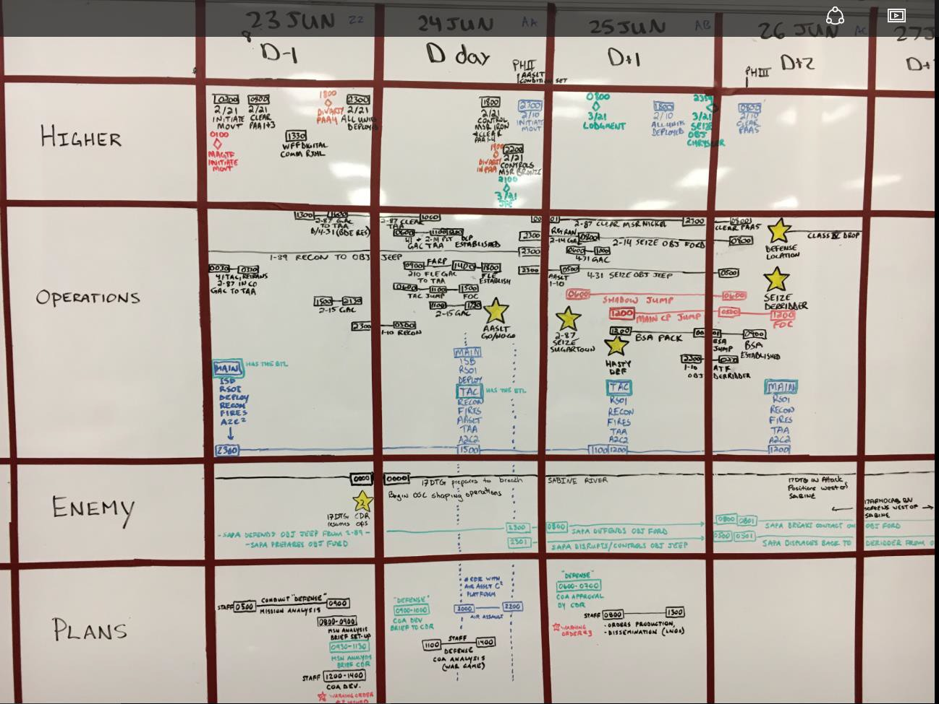
HOPE Timeline “TTP”
Implementation TTPs:
The timeline should be displayed in the TOC for all the staff to review each day.
The timeline should be managed primarily by the BDE XO and then the BDE S3 and OPNs SGM.
You should start building the HOPE Timeline during Step 1, Receipt of Mission of the MDMP.
Should have a timeline across the top.
The Operations row should be followed by the Enemy row.
The Plans row assists you to synch your next cycle of MDMP Steps for a new order with the current fight activates listed on the Ops Section.
17

Slide 23
HOPE Timeline “TTP”
18

Slide 24
MDMP Step 1: Receipt of Mission
19

Slide 25
Step 1: Receipt the Mission “Framing the Problem” (TTP)
O/C-T Observed Trends | Cost | Fix
Staffs skip Step 1: Receipt of Mission all together and blow right into Step 2: Conduct Mission Analysis. | The staff does not have a shared understanding of the problem that the XO is asking them to analyze and produce a quality mission analysis. | - Make this step a part of your PSOP and set time aside to brief the staff using the recommended agenda below.
Staffs turn this step into a major drawn out production by building slides, briefing formats, conducts a rehearsal prior to the huddle, etc. | Staffs waste time trying to produce new products that are not needed. | Most of the required products should already be provided by the higher HQs order. This should be a 10-15 minute update to the staff gathered around a map & timeline!
Review Initial Higher HQs Graphics (Specified OBJs, AO, phase lines, etc.) Operational Timeline, i.e. Cross LD NLT, Clear OBJ X NLT, etc.
Types of operations the unit is most likely to execute (air assault, ground attack, airborne, etc).
Brief Enemy Overview, i.e. Co (+) on OBJ X, BN (-) in Zone, etc
Identify initial Brigade Fights
Initial Guidance for Collection & Recon Requirements
Fighting Products Required to Produce (EXCHECK, DSM, etc)
This is the start of “See Ourselves”
These are LTPs
recommended “minimum” topics to cover with the staff…
Step 1: Receipt of Mission
Step 2: Mission Analysis
Only two key outputs for step 1:
Start of “See the Enemy”
Cdr’s Initial Guidance
Initial Allocation of Time
Another way of saying this is the XO is “Framing the Problem” for the staff before jumping into Step 2: Mission Analysis!
The level of detail information to cover during this step is based on:
Level of Staff organization, rank, experience, time in unit, understanding of PSOP, number of MDMP repetitions, etc.
When in doubt more information is better!
20

Slide 26
TTP: Receipt of Mission Huddle (Framing the Problem) |  |  | References: FM 6-0, Ch 2, Chapter 9
Purpose: Provide Commanders input to MDMP and establish a common understanding among the staff at the very beginning of MDMP. | When: As soon as possible after Receipt of Mission. | Participants: BCT CDR, all available planning staff members and LNOs. Facilitator: BCT S3
Tools to Bring: S3: Analog Map with Higher Graphics and NAIs BCT Initial Graphics (AI/AO, Objectives, Enemy SITTEMP, – whatever graphic information is available at the receipt of mission). S2 Higher level SITTEMP, Higher level NAIs Higher level Collection Matrix Overall – Do not create anything for this huddle you wouldn’t already create for mission planning – Maps, timeline, markers and whiteboard/butcher block and products you were given by higher headquarters should be enough | Agenda (this is intended to be presented with minimal preparation): S3 Today is: The time period that we're planning for is to . We are at and will operate in the country of . The Corps and Higher level AOs. Higher and adjacent unit missions. Our AO/AI and major terrain features. The battlefield geometry. How we are related to the Higher level ME. The objectives in our AO (Initial Graphics from higher) The unit’s Task and Purpose What have we been tasked to do and when using the Operational Timeline. Type of operations the unit is most likely to execute (air assault, infil, etc.) S2 Here's how many we're fighting on each objective and when. The weather expected during our period of operations. XO MDMP or at a minimum Mission Analysis Timeline. How we are collecting and sharing products – location and address. What touchpoints does CDR want and when? MDMP Timeline: Next event. CDR The Brigade Fights (first assessment – refined after MA). Guidance for Info Collection. Initial reconnaissance requirements (for CAV and higher assets). Initial Guidance for Mission Analysis. Required fighting products to produce.
Bottom Line: This intentionally minimal-product huddle serves to focus the staff’s mission analysis efforts on the Commander’s anticipated fights, and provide the Commander an opportunity to influence initial planning efforts.
21

Slide 27
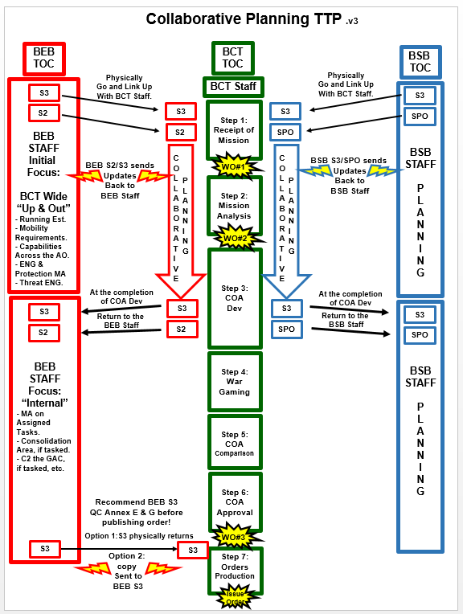
BEB & BSB Collaborative Planning TTP:
Trend: BCT XOs and their staffs struggle on how to take advantage of the BEB and BSB staff expertise during the BCT level MDMP.
Example: Often on the BCT staff the BEO (Brigade Engineer Officer) is a young, pre-command CPT, with limited experience on Brigade level operations. They are also often made A/S3 inside the S3 section or a BTL CPT.
Cost: The BEO does not have the time or experience to focus 100% on mobility, counter mobility, engineer and protection, reverse WfF functions, etc. Therefore, these critical portions of the OPORD and or ANNEXs do not receive the field grade / ILE graduate level attention as other portions of the order.
Fix: Pull in the BEB S2 and S3 and BSB S3 and SPO during critical BCT Level MDMP. These individuals will conduct collaborative planning with the BCT Staff through Step 3 of the MDMP. They can send updates back to their BN HQs throughout the MDMP Step 1 through Step 3. At the completion of Step 3 they return back to their BN HQs staff with a better understanding of their BNs requirements, but more importantly they have had a direct impact on those tasks and have assisted in setting the Brigade up for success.
22
27

Slide 28
Building the Operational Framework: TTP
O/C-T Observed Trends | Cost | Fix
Staffs do not understand how to build a doctrinally correct operational framework. | Commander’s and their staffs fail to achieve shared visualization because the framework is poorly communicated and misunderstood. | Commander apply and describe the battlefield framework to be applied during STEP 16 of Mission Analysis (Develop and Issue Planning Guidance)
Staffs use all three of the Operational Frameworks in conjunction with phases.
IAW FM 3-0, C1 dated 6 Dec 2017
Commander “conduct” Decisive - Shaping – Sustaining to articulate an operation in terms of purpose.
Commander “designate” Main & Supporting Efforts to designate the shifting and prioritization of resources.
Commander “can” designate Deep - Close – Support – Consolidation Area to describe the physical arrangement for forces in time, space, and purpose.
- Common Staff Mistakes: Staffs try to combine all three operational frameworks plus add in phases to the operation which is extremely confusing to everyone.
- Recommendation:
We have seen the most success when units use the combination of Decisive – Shaping – Sustaining in conjunction with the Main and Supporting Efforts. Brigade and Battalion staffs are familiar with the main effort and supporting effort concept and the decisive-shaping-sustaining framework is easier to understand.
PHASE | I – RECON | II – MOVT TO PL DOG | III – ASSLT OBJ GRANT | IV DEF ON PL CAT
DECISIVE-SHAPING-SUSTAINING | SHAPING | SHAPING | DECISIVE | SUSTAINING/SHAPING
3-71 CAV | ME | SE | SE | SE
1-32 IN | SE | ME | SE | SE
1-87 IN | SE | LAST OOM | ME | SE
2-22 IN | SE | SE | SE | ME
7 EN | SE | SE | SE | SE
23

Slide 29
MDMP Step 2: Mission Analysis
24

Slide 30
BCT Mission Analysis Brief – “A Way”
MA Briefing Trends:
BCT staffs struggle to present an effective MA Brief to the CDR.
XOs want to minimize the number of slides and briefers.
Staff wants to brief all of their analysis, i.e. They brief everything “they know” vs briefing only what the “CDR needs to know.”
The CDR needs to understand his staff’s analysis of the OE, the enemy, the HHQ plan, and the tasks assigned to the BCT, but doesn’t have the time for all of the details.
Solution requires a balance: present the relevant details in a
way that efficiently streamlines presentation and understanding.
Use PowerPoint / CPOF slides where appropriate (S2 terrain products, staff quad/quint/etc charts) and map overlays (HHQ graphics, range arcs, SITEMP, etc)
“Tell the story” to the CDR: flow from big picture to micro-view:
This is where are (AO/AI/AOI)
This is the big picture (strategic/operational situation)
This is the operational environment (weather, terrain, civil considerations, ROE)
This is the enemy (OOB, capabilities, vulnerabilities, SITEMP, COAs, HVTs)
Here are some initial information collection priorities
This is our HHQ plan and how we fit in (mission / intent / maneuver / fires)
These are our tasks (specified, implied, essential) and the forces available
This is our analysis by WfF (facts, assumptions, constraints, assets available, shortfalls and RFIs, risks, recommendations, COA recommendations)
This is our proposed mission statement
These are the proposed CCIR
Here are the risks we see and the potential mitigations
Mission Analysis Agenda
Area of Interest / Area of Operations
Description of the Big Picture (strategic / operational)
* Some units add their proposed mission statement up front here, not for approval, but just to add content before they bombard the Cdr with massive amounts of data.
Description of the Operational Environment and its effects on friendly, enemy, and civil operations
Weather
Terrain
Civil Considerations (including ROE)
Description of the Enemy
OOB, capabilities, vulnerabilities
Enemy MLCOA (SITEMP, statement, HVTs)
Enemy MDCOA (SITEMP, statement, HVTs)
Initial Scheme of Information Collection and IC Matrix
HHQ Concept of Operations (mission, intent, maneuver, fires) two echelons up
How do we fit into the HHQ concept
Our tasks (specified, implied, essential)
Analysis by Warfighting Function related to our tasks within this OE facing this enemy
Facts
Assumptions
Constraints
Assets available
Shortfalls (including information)
Risks
Recommendations
RFIs
COA Development Recommendations
Proposed Mission Statement
Proposed CCIR
Initial Risk Management
Commander’s Planning Guidance
Updated planning timeline
25

Slide 31
CCIR Matrix TTP
Our PIR are tied
to our Decision Points. However, units fail to link their FFIR & EEFI to
the same Decision Points. Their FFIR & EEFI are just random points that cannot be directly linked to their Decision Points.
Decision Point | 1: Execute Deep Attack 1 | 2: Execute Air Assault | 3: Shift Main Effort from TF 1/21 SBCT to TF 2/21 SBCT | DP 4: Commit the Division Reserve
PIR | PIR 1: Where will 17 & 18 DTG employ AD systems? (LTIOV: 091600JUL 20) SIR A: Where are AD systems along air routes? (LTIOV: 091600JUL 20) PIR 2: Where will 17 & 18 DTG employ FA systems? (LTIOV: 091600JUL 20) PIR 3: How will 17 & 18 DTG withdraw towards the IB? (LTIOV: 091600JUL 20) SIR A: Where will the 18 DTG defend vicinity OBJ ST LOUIS? (LTIOV: 091600JUL 20) PIR 4: Will weather meet min reqt from H-1 to H+8? (LTIOV: 092230JUL 20) | PIR1: Where will 17 and 18 DTG employ AD systems?(LTIOV: 102130 JUL 20 ) SIR A: Where are AD systems vicinity LZs? (LTIOV: 102130 JUL 20) SIR B: Where are AD systems along air routes? (LTIOV: 102130 JUL 20) PIR 2: Where will 17 and 18 DTG employ FA systems? (LTIOV: 102130 JUL 20 ) SIR A: Where are IDF that can affect the AASLT? (LTIOV: 102130 JUL 20) PIR 4: Will weather meet min reqt from H-1 to H+8? (LTIOV: 102130 JUL 20) | PIR 5: Will bridges on the Sabine River support 21 ID Operations? (LEIOV: Lead STRYKER CO vicinity PL HOOD) SIR A: What is the status of bridges on OBJ TUCSON? ( LEIOV: Lead STRYKER CO vicinity PL HOOD) SIR B: What is the status of bridges on OBJ PHOENIX? ( LEIOV: Lead STRYKER CO vicinity PL HOOD) PIR 6: When will the enemy employ CHEM Munitions in AO STAG? ( LEIOV: Lead STRYKER CO vicinity PL HOOD) | PIR 7: What is the status of LA Hwy 10 to MSR IRON? (LEIOV: End of PH IV) SIR A: Will the enemy employ chemical munitions along LA Hwy 10? (LEIOV: End of PH IV)
FFIR | FFIR1: Loss of 24 x AH-64 FFIR 2: Inability to execute the SEAD Program | FFIR 3: Loss of more than 5 x UH-60 and/or 2 x CH 47s FFIR 4: Inability to execute the SEAD Program FFIR 5: Weather mins do not support CAS and EW FFIR 6: Inability to sustain forces forward on OBJ RENO/DENVER | FFIR 7: Bridges unable to support MLC 70 class vehicles FFIR 8: Loss of 1 Bridge Platoon FFIR 9: Units receive CHEM attack that delays movement. | FFIR 10: Loss of 1 x BN of TF 1//21 SBCT west of PL GRANT
EEFI | EEFI 1: Deep Attack Plan | EEFI 2: Loss/Compromise of Operations Graphics EEFI 3: Air Assault Plan and Timings | EEFI 4: Location of PRI/ALT routes for TF 1/21 SBCT in AO STAG EEFI 5: MOPP Status EEFI 6: DECON capabilities and sites | EEFI 7: Location, Disposition, and Composition of the DIV Deserve EEFI 8: Routes support DIV Reserve Movement
Noticed how the
PIR & FFIR are directly tailored for each specific Decision Point.
Even though EEFI is
no longer a part of CCIR, it still should nested
with each specific Decision Point listed above and listed on the same matrix with PIR & FFIR.
26

Slide 32
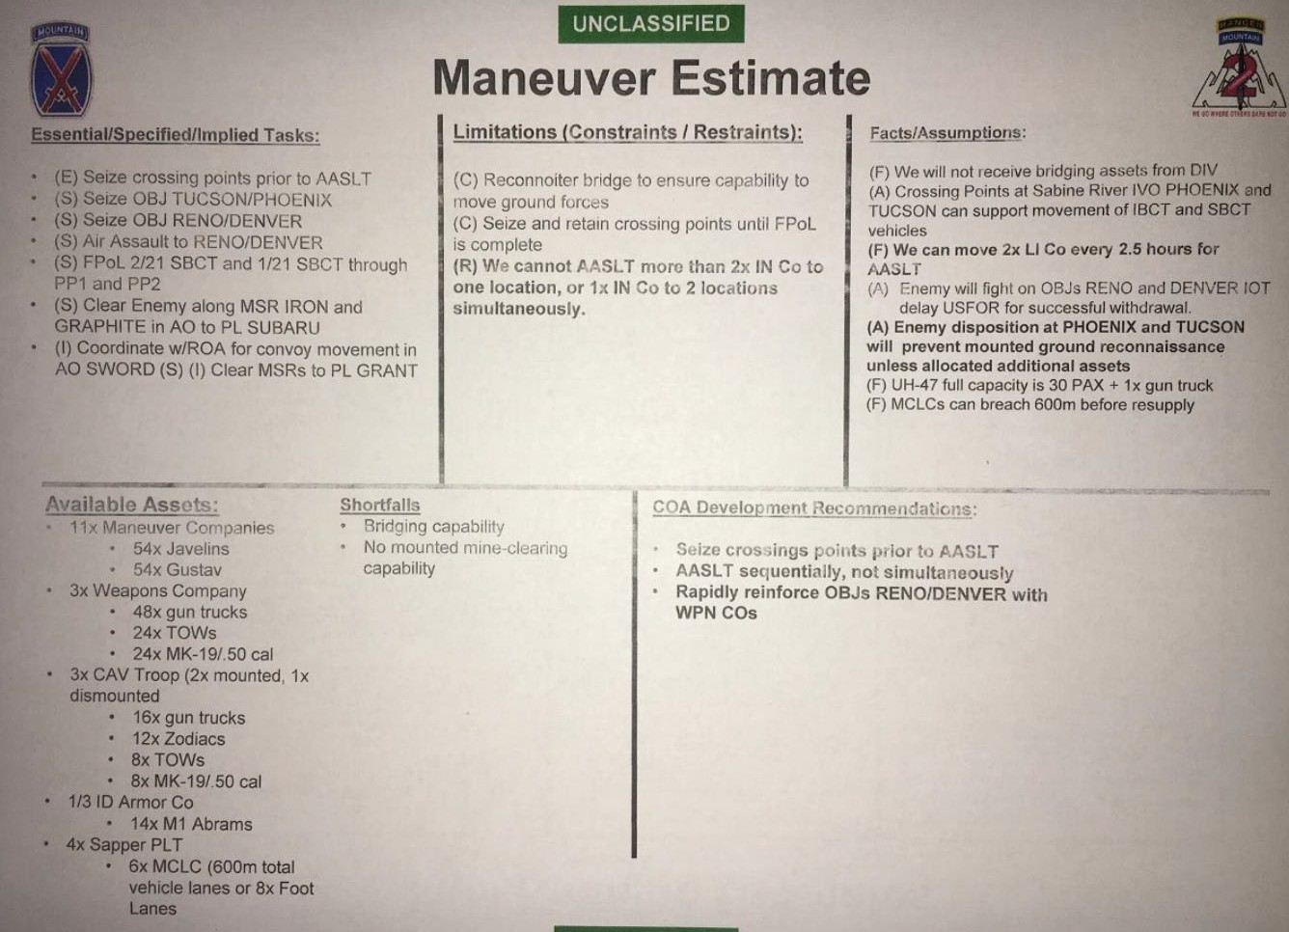
A great TTP is to add a section to each WfF Staff Estimate slide that allows the staff to provide the Commander COA Development Recommendations.
The Cdr can take all those recommendations and refine his planning guidance, if needed based on the staff’s analysis.
27

Slide 33
Mech Assets Mission Analysis (TTP)
One of the last steps of Mission Analysis is “develop and issue planning guidance.” It is the staff’s responsibility to help the commander visualize and understand what his forces can and cannot do before he writes out his planning guidance. In doing so the commander can “describe when, where, and how he intends to employ combat power to accomplish the mission.”
Two key critical assets most units have available at LTP and are routinely overlooked during mission analysis are aviation and mechanize forces.
Do the homework (science) and let the commander know options available for both assets in order for him give
the staff detailed planning guidance.
You know where you are!
You know your forces available!
So…answer the “So What!” for the Cdr
You know where you going!
Mission Analysis Mech Force Playbook
Play # | From | To | Tactical Ground Force | Time for Movement | Refuel Needed | Time To Refuel | Location of Refuel | “So What”
1 | TAA DAGGER | OBJ X | 10 x M1s 5 x M2s | 3 hours 20 Minutes | No | N/A | N/A | - If the Mech forces are pushed West of OBJ X they will need to be refueled.
2 | TAA DAGGER | OBJ Y or to PL RED | 10 x M1s 5 x M2s | 5 hours 15 minutes with 90 minute refuel | Yes | 90 Minutes | Vic PL BLUE | - Recommend waiting until H+12 until wheels up on air assault in order to synch the Mech force with air assault force on OBJ Y.
28

Slide 34
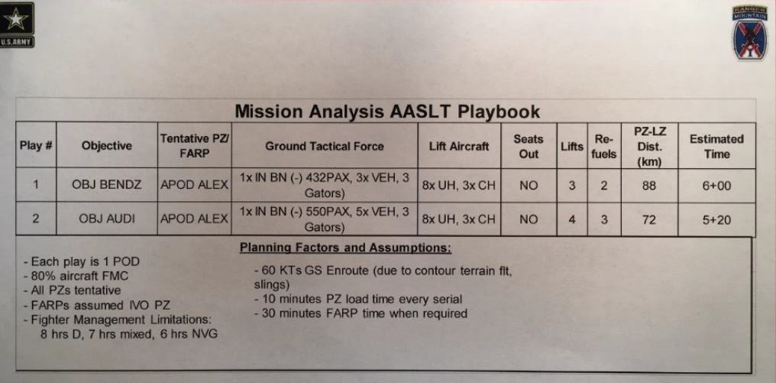
Avn Assets Mission Analysis (TTP)
One of the last steps of Mission Analysis is “develop and issue planning guidance.” It is the staff’s responsibility to help the commander visualize and understand what his forces can and cannot do before he writes out his planning guidance. In doing so the commander can “describe when, where, and how he intends to employ combat power to accomplish the mission.”
Two key critical assets most units have available at LTP and are routinely overlooked during mission analysis are aviation and mechanize forces.
Do the homework (science) and let the commander know options available for both assets in order for him give the staff detailed planning guidance.
You know where you are!
You know your forces available!
You know where you going!
So…answer the “So What!”
The Science!
29

Slide 35
Enemy Vulnerabilities Matrix (TTP)
As of: 16 April 2019 .v2
Enemy Vulnerabilities | Whose Fight (Div / Bde / Bn) | Exploitation (What we can do to the enemy) | Exploit When: (Phase / Date / Time)
Movement & Maneuver
EN in fixed positions tied to defense of the obstacle; largely tied to roads due to marshy off-road conditions. | BN | Envelope OBJ Benz from a direction his defenses are not facing and soften with IDF to limit his maneuverability | Phase 2: Movement to Assault Positions
EN already atritted below 75% strength; reserve support is no more than a company in 6 hours. | BDE | Have JTF Identify and defeat enemy intentions west of Sabine River IOT isolate Benz and Audi | Phase 3: Assault of OBJs Audi and Benz
Fires
2S19 BN must position between PL BLUE and PL GREEN to range OBJ KNIFE with chem fires. | Division | DIV targets 2S19 BN (HPTL #2) and attacks with AI and HIMARS | Phase 1: Recon
ZSU-23-4s operate visual detection mode (no radar capability). | BCT | ZSU-23-4 positioned within 2km of likely LZs – Shadow and AH-64 find and target. | Phase 1: Recon
Intelligence
EN relies heavily on FM communication between recon elements and main body forces. | Div | Conduct EW to cut off EN information flow between recon and main body forces. | Phase 2: Assaults on OBJs Audi and Benz
Mission Command
EN communication platforms are easily identifiable. | Div | Use EW for jamming and DF to locate critical EN C2 nodes. | All Phases
Protection
EN has limited counter mobility capability to employ complex obstacles limits their ability to slow / attrit advancing forces. | BCT | Task organize mobility assets to rapidly clear obstacles on primary routes | Phase: 2 and 3 seize Objs Audi and Benz
EN had limited engineer survivability assets to construct prepared positions to protect key MC and AD assets | BCT | Target MC nodes and armor with fires and attack aviation | Phase: 1 Recon
SAPA Offensive chemical capability limited to non- persistent (CS/Chlorine). | BCT | MOPP Ready posture maintains higher tempo to rapidly secure objs and reduce likelihood of chemical use | Phase: All
Sustainment
N/A
30

Slide 36
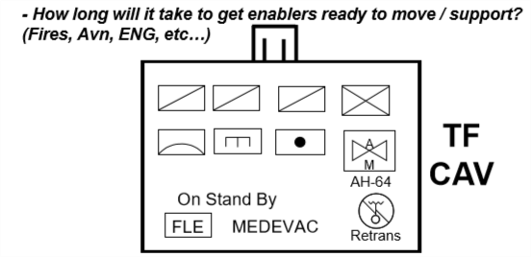
Information Collection Meetings
Problem: What is the best and most timely way to answer my Commander’s PIR?
Conditions To Consider:
Amount of time unit has been in theater
“Cold Start” mission analysis or second or third mission in AO
Distance to travel to enter sector/AO or to get to NAIs
NLT / NET times directed in order for entering AO
How much travel time does CAV need to collect on PIR
Consider total number of periods of darkness (POD)
Type of recon (area vs zone)
Do you have your directed objectives, routes, axis, etc from Division
Type of mission: movement to contact, deliberate attack, defense, etc
Step 1 Receipt of Mission
Step 2 Mission Analysis
Mission Analysis Brief
Information Collection Meeting
Issue WO #2
Step 3 COA
Dev
Step 4 War Gaming
Step 7 Orders Production
BCT initial CCIRs & EEFIs
BCT Msn Statement
Initial
ANNEX L
Start Annex L
41% - 65% Complete
66% - 85% Complete
Collection Plan
National Assets ATO Cycle Corps/Div UAS
100%
Complete
BCT UAS BCT AVN
- “When do I employ the CAV?”
DP
Initial Information Collection Plan………………………..…..turns into…..……………..………..……….ANNEX L
Initial NAIs tied to MLECOA & MDECOA
Higher HQs PIRs
31

Slide 37
37
TTP: Receipt of Mission Huddle (Framing the Problem) |  |  |  | References: FM 6-0, Ch 2, Chapter 9
Purpose: Provide Commanders input to MDMP and establish a common understanding among the staff at the very beginning of MDMP. | When: After Receipt of Higher Mission. |  | Participants: BCT CDR, all available planning staff members and LNOs. Facilitator: BCT S3 |  | Outcome: Staff shared understanding of higher mission, received CDR’s planning and collection guidance.
Tools to Bring: S3: Analog Map with Higher Graphics and NAIs BCT Initial Graphics (AI/AO, Objectives, Enemy SITTEMP, – whatever graphic information is available at the receipt of mission). S2 Higher level SITTEMP, Higher level NAIs Higher level Collection Matrix Overall – Do not create anything for this huddle you wouldn’t already create for mission planning – Maps, timeline, markers and whiteboard/butcher block and products you were given by higher headquarters should be enough |  | Agenda (this is intended to be presented with minimal preparation): S3 Today is: The time period that we're planning for is to . We are at and will operate in the country of . Our AO/AI and major terrain features. The battlefield geometry. The Corps and Higher level AOs. Higher and adjacent unit missions. How we are related to the Higher level ME. The objectives in our AO and what have we been tasked to do there, when. S2 Here's how many we're fighting on each objective and when. The weather expected during our period of operations. XO MDMP or at a minimum Mission Analysis Timeline. How we are collecting and sharing products – location and address. What touchpoints does CDR want and when? MDMP Timeline: Next event. CDR The Brigade Fights (first assessment – refined after MA). Guidance for Info Collection. Initial reconnaissance requirements (for CAV and higher assets). Initial Guidance for Mission Analysis. Required fighting products.
Bottom Line: This intentionally minimal-product huddle serves to focus the staff’s mission analysis efforts on the Commander’s anticipated fights, and provide the Commander an opportunity to influence initial planning efforts.
32

Slide 38
TTP: Information Collection Meeting |  |  |  | References: ATP 2-01, Chapter 4 ATP6-0.5, App A Page 20 FM 3-55, Chapter 3 FM 6-0, Ch 2, Chapter 9 FM 6-0, Ch 2, Appendix D, Page 62
Purpose: Commander provides reconnaissance planning guidance facilitating parallel Cavalry Squadron following mission analysis. | When: Cold Start: After MA brief. Warm Start: after Initial Targeting & before MA brief |  | Minimum Participants: BCT CDR, S2, S3, Fires, CAV CDR/S3/LNO, BAE, SOF LNO Facilitator: BCT S3 |  | Outcome: HPTs reflected on Collection Matrix. CAV assigned tasks resources to begin mvmt. EAB IRs requests approved.
Tools to Bring: S3: Analog Map with Higher Graphics and NAIs BCT Initial Graphics (AI/AO, Objectives, Higher level Enemy SITTEMP) Operational Timelines S2: Event Template w/proposed NAIs HVTL Working PIR w/Indicators and SIRs Initial Information Collection Sync Matrix Collection Manager: Collection Assets Available (Higher, DS, & Organic) Specified Collection Tasks from Higher Initial Information Collection Overlay Initial Information Collection Matrix Initial Collection T&P by Unit & Higher Supporting Assets FSCOORD/FSO: Higher level Target List Worksheet Higher level HPTL BAE: Aviation Assets Available S9: HNSF Interagency & other Orgs Info capabilities SOF LNO: Locations and missions |  | Agenda (given the best information available): S3 (drives the meeting – chairs if CDR not present) CDR’s IC Guidance, BDE Fights, IC Mtg 1 Guidance Time period to be covered/operations during that period S2 Anticipated enemy set and most likely enemy COA Reviews MA Brief-approved PIR and supporting indicators, SIRs, and NAIs Collection Manager Review Collection Assets Available S3 Leads: S3 - Defines Time Period(s) Repeat for S3 - BDE Fights during this time (S3) _{each time} ^{S2 PIRs} period covered FSO - HPTs Recommended Collector (CM) S3: CAV Focus Tasks & Purposes. Control Measure Task Org CASEVAC Maneuver Command & Control Fires, RW CAS, EW, CAS, etc
Bottom Line: With the benefit of the Initial Targeting Meeting, parallel planning by CAV, AVN, BEB, and BSB, and MA Analysis, the BCT provides enough information, guidance, and resources to employ the CAV in support of BCT Objectives
33

Slide 39
TTP: Initial Targeting Huddle |  |  |  | References: ATP 3-60 Targeting ATP 3-09.42 Fire Spt for the BCT
Purpose: Develop the initial HPTL and provide input for the Information Collection Meeting |  |  | When: After Reverse WfF Analysis and before the MA Brief |  | Participants: S3, S2, FSO, Tgt Off, FAIO, FA S2 (FSCOORD if available) Lead – S3
Tools to Bring: Running Estimates HVTL Draft FSTs Draft NAIs CDR’s Initial Planning Guidance |  | Agenda: S3 reviews CDR’s initial guidance S2 briefs HVTL FSO briefs draft FSTs FSO leads development of HPTs Tgt Off leads D3A of HPTL S3 reviews outputs |  |  |  | Outputs: Draft HPTL Updated NAIs Draft TAIs Draft collection requirements
 | Bottomline: The key members of the BCT Targeting Team huddle for +/- 20 mins to begin the DECIDE step of D3A in order to focus initial collection requirements and asset allocation on HPTs.
34

Slide 40
Running Estimates
References: FM 6-0, C2
Purpose: Continuous assessment of the current situation used to determine if the current operation is proceeding according to the cdr’s intent and if planned future operations are supportable
Trends: Staff elements fail to have or maintain running estimates focused on how its specific areas of expertise are postured to support future operations.
Staff Responsibilities: The commander and each staff element maintain a running estimate.
* Generic base running estimate format below for consideration
RUNNING ESTIMATES IN PLANNING :
During planning, running estimates are key sources of information during mission analysis.
SITUATION AND CONSIDERATIONS.
Area of Interest. Identify and describe those factors of the area of interest that affect
functional area considerations.
Characteristics of the Area of Operations.
Terrain. State how terrain affects a functional area’s capabilities.
Weather. State how weather affects a functional area’s capabilities.
Enemy Forces. Describe enemy disposition, composition, strength, and systems within a functional area. Describe enemy capabilities and possible courses of action (COAs) and their effects on a functional area.
Friendly Forces. List current functional area resources in terms of equipment, personnel, and systems. Identify additional resources available for the functional area located at higher, adjacent, or other units. List those capabilities from other military and civilian partners that may be available to provide support within the functional area. Compare requirements to current capabilities and suggest solutions for satisfying discrepancies.
Civilian Considerations. Describe civil considerations that may affect the functional area, including possible support needed by civil authorities from the functional area as well as possible interference from civil aspects.
c. Facts/Assumptions. List all facts and assumptions that affect the functional area.
MISSION. Show the restated mission resulting from mission analysis.
COURSES OF ACTION.
List friendly COAs that were war-gamed.
List enemy actions or COAs that were templated that impact the functional area.
List the evaluation criteria identified during COA analysis. All staffs use the same criteria.
ANALYSIS. Analyze each COA using the evaluation criteria from COA analysis. Review enemy actions that impact the functional area as they relate to COAs. Identify issues, risks, and deficiencies these enemy actions may create with respect to the functional area.
COMPARISON. Compare COAs. Rank order COAs for each key consideration. Use a
decision matrix to aid the comparison process.
RECOMMENDATIONS AND CONCLUSIONS.
Recommend the most supportable COAs from the perspective of the functional area.
Prioritize and list issues, deficiencies, and risks and make recommendations on how to
mitigate them.
Based on the mission and the initial commander’s intent, the
staff develops one or more proposed courses of action (COAs) and continually refines its running estimates to account for the mission variables.
The updated running estimates then support COA analysis (war-gaming) in which the staff identifies the strengths and weaknesses of each COA. The staff relies on its updated running estimate to provide input to the war game.
Following COA analysis, the staff compares the proposed COAs against each other and recommends one of them to the commander for approval. During all these activities, each staff element continues to update and refine its running estimate to give commanders the best possible information available at the time to support their decisions. The selected COA provides each staff element an additional focus for its estimates and the key information it will need during orders production.
Key information recorded in the running estimate may be included in
orders, particularly in the functional annexes.
Bottom Line: The base running estimate completed before MDMP begins that addresses information unique to each functional area is essential to success. Each staff element identifies functional area friendly and enemy strengths, systems, training, morale, leadership, and weather and terrain effects, and how all these factors impact the operational environment, including the area of operations.
35
8

Slide 41
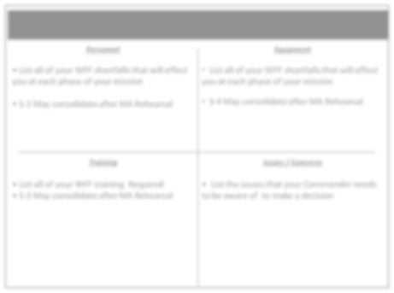
Examples of Staff Quad Charts
Bottom Line:
Staff officers can present using quad charts as a summary of their running estimates from their specific functional area and how their findings impact or are impacted by other areas.
Quad Charts are great tools to synthesize information and provide it to help commanders build and maintain their situational understanding.
36
9

Slide 42
REVERSE WARFIGHTING FUNCTION (WFF) WORKSHEET
DTG: WFF:
Enemy Personnel Strength (your WFF only):
1.
2.
3.
4
5.
6.
7.
8.
OPORD Annex#: Name:
Enemy Weapons /Equipment (your WFF only):
1.
2.
3.
4.
5.
6.
7.
8.
Enemy Capabilities (what CAN he do to impede our mission with the above, in sequence as applicable):
1.
Enemy Vulnerabilities (what can we do against him based on the above, in sequence as applicable):
1.
2.
3.
4
5.
6.
This is the most over looked portion of Reverse WfF Worksheets.
It is one of the most important pieces of data we need to carry forward into COA Development!
We should develop our COA around exploiting these vulnerabilities!
2.
3.
4
5.
6.
7.
7.
Most Probable Employment (what WILL he HVTs:
do) ^{1.}
_{1.} 2.
_{2.} 3.
3. ⁴
₄ 5.
5.
37

Slide 43
REVERSE WARFIGHTING FUNCTION (WFF) WORKSHEET
(cont.)
Key Effects of the Environment (on your WFF and on your enemy counterpart) Weather: Friendly 1. 2. 3. 4 Enemy 1. 2. 3. 4. | Terrain: Friendly 1. 2. 3. 4. Enemy 1. 2. 3. 4.
Civil Infrastructure: Friendly 1. 2. 3. 4. Enemy 1. 2. 3. 4. | Populace: Friendly 1. 2. 3. 4. Enemy 1. 2. 3. 4.
⁴ 38
3

Slide 44
Reverse Warfighting Function Huddle |  |  |  | Lead: BCT S2 Chaired by: BCT XO or S3 Duration: 20 to 30 Minutes
Purpose: To facilitate staff development of a comprehensive, integrated intelligence preparation of the battlefield (IPB). | When: Occurs during Step 2: Mission Analysis. |  | Minimum Participants: Prim. Staff, WfF leads, FSO, IO, ENG, ADAM, MP, BAO, CBRN, EWO, MEDO, SJA, ALO. |  | Outcome: The S2 has a better understanding how the enemy will fight and use his assets to support his concept. Input is used during IPB process
Inputs: Commanders initial guidance. Higher HQ IPB. Operational environment assessments from external sources. Staff running estimates. Reverse WfF Worksheets. * Staffs consider the following when developing input for the S2 Terrain and weather effects on friendly and threat operations. Effects of civil considerations on friendly and threat operations. Disposition, composition, capabilities and vulnerabilities of threat forces. Opportunities to mitigate threat capabilities and exploit threat vulnerabilities. High-value targets. Application to threat COAs. Potential intelligence gaps. Outputs: Recommended input to the staff’s initial IPB. Identification of initial intelligence gaps. Enhanced staff understanding of the impact of terrain, weather, civil considerations, and the threat on operations. Updated staff running estimates. |  | Trends: The BCT XO does not consider when the huddle should occur on his MDMP timeline and either 1) forgets about the huddle all together, 2) it occurs too late in the process and the S2 does not have enough time to use the information in his IPB, 3) does not give the WfF leads enough time to prepare.
 |  | Agenda (given the best information available): S2 Purpose of the Huddle. Any Enemy Updates the staff needs to know since the initial “Framing the Problem” huddle during Step 1: Receipt of Mission WfF Leads briefs off their Reverse WfF Worksheets. WfF Leads should focus on explaining how the enemy will use his WfF capabilities and any enemy vulnerabilities. Movement & Maneuver Lead Fires Lead Protection Lead Sustainment Lead Command & Control Lead S2: Clarification or Issue Review XO: Guidance to the staff
Bottom Line: The BCT S2 cannot be the subject matter expert on all WfF capabilities. It is the entire staffs responsible to assist the BCT S2 in fine tuning the enemy’s MLCOA and MDCOA within their WfF expertise.
39

Slide 45
IO / Non-lethal Mission Analysis Example
IO Systems A/413 CA – 1x CMOC, 4x CAT C/344 PO Det – 4x TPT 2 of 2 VMAX 2 of 2 Prophet 1x PAO, 3 of 4 BN UPAR EAB – EA-18 Growler, EC-130J Commando Solo, EC-130H Compass Call, RC-135V/W Rivet Joint | Facts Civ and Govt controlled media (radio, TV) reach pop in AO EAB requests require 72 hours 1x newspaper in AO 1x radio station in AO No TV station in AO HN is lead for handling DPs DIV has approved PO products for BCT use | Assumptions Civ pop will support HNSF and CF once enemy pushed out of AO Civ pop will remain in place during initial attack but 25% will move west during consolidation SPF will use DPs to move into rear areas | Draft BCT IO OBJs Degrade enemy C2 to prevent sync of cbt power Influence civ pop to minimize interference with CF operations to prevent civ casualties Disrupt enemy use of media outlets to minimize propaganda
Info Environment Radio is best medium to reach the civ pop Religious leaders are key communicators to civ pop | Constraints DIV CDR approves new PO products Submit PO product reqs to 344 PO CO Coordinate all contact with Prov civil auth through US Consulate | Shortfalls / RFIs Shortfall – N/A RFI – HN DP plan? RFI – What OCO are available? | BCT HPTL Noms Radio station in Town A Imam of Town A mosque
IO Tasks to BCT Identify key communicators within AO to deliver non- interference messages (specified) Secure MPS and other key infrastructure (specified) Establish LNO team with US Consulate (implied) |  | COA DEV Recommendations Use SLE and PO products to support non-interference messages Use AEW to deny enemy C2 comms during AASLT Use AEW to jam radio station in Town A following AASLT until OBJ X secured and OBJ Y enemy destroyed
40

Slide 46
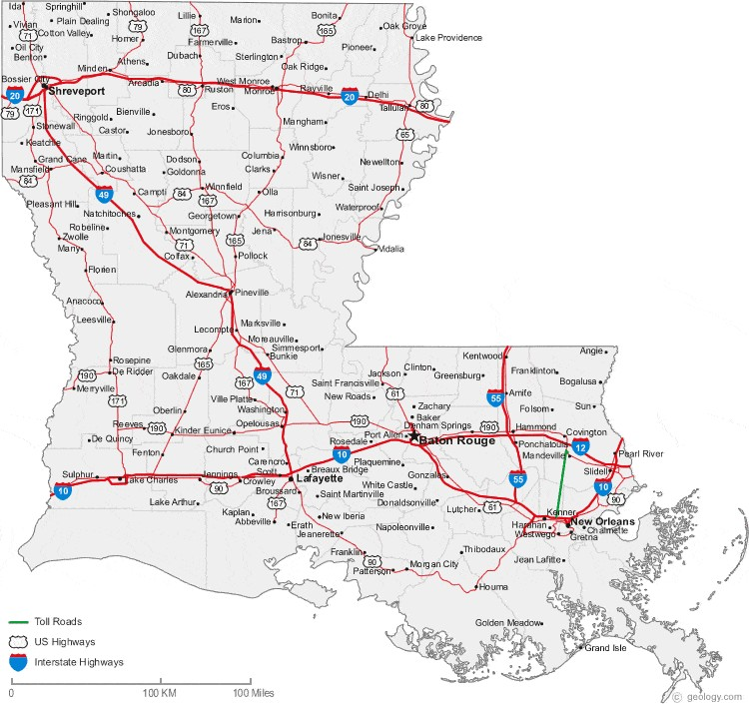
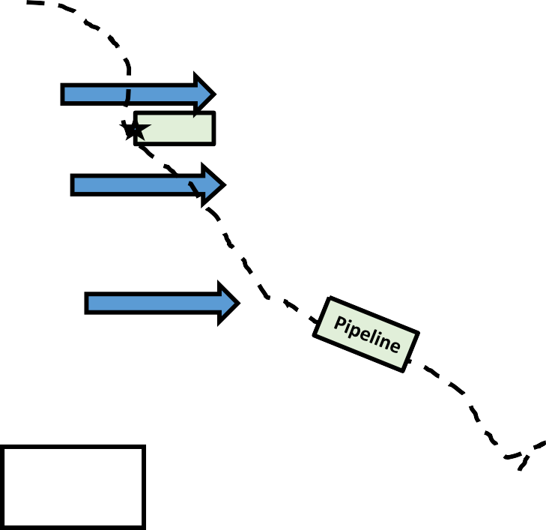
IO Mission Analysis - PMESII-PT Analysis
LTP TTP
Reference: FM 3-13
Republic of Atropia
POLITICAL: Political issues stem from South Atropian separatists and those upset by lack of adequate utilities, uneven justice system, and substandard social services
MILITARY: SAPA is the most serious internal threat and enjoys significant support among ethnic Persian population. Arianian conventional threat is not manageable by GOA/ASF. ASF mostly equipped with old Soviet/Russian systems with limited tier 2 NATO systems.
ECONOMIC: Localized conflict stagnating economy resulting in shortages of most consumer goods. Large oil and natural gas reserves. Political patronage depresses economic growth.
SOCIAL: Population mostly ethnic Atropian Sunni Muslims. 69% Atropian, 25% Persian, 6% other. 99% literacy rate. 1 to 2 million IDPs driven by conflict towards eastern regions. 52% of population urban.
INFORMATION: Free, but monitored media environment, Growing INFOWAR capabilities in SAPA with IRA support
INFRASTRUCTURE: Oil and natural gas facilities/pipelines critical to long-term economic growth. Road system limited. Rural areas lack modern water, electricity, and sewage systems.
IDP Flow
Dara Lam
IDP Flow
IDP Flow
Baku
41

Slide 47
IO Mission Analysis - PMESII-PT Analysis
LTP TTP
Reference: FM 3-13
Unified Action Partner Analysis
 | USG Joint/Interagency Efforts in Atropia | International/Multinational Efforts in Atropia | BCT AO Considerations
Governance | US Dept of State Enhanced security More democratic governance Sustained, diversified economy | Government of Atropia Improving human rights Legal rights for women Combatting corruption | US Consulate Dara Lam (2- star HQ eqivilent) Early link to integration with local civil authorities Host Nation lead for DPREs
Security | US Dept of Defense Deter aggression Assure regional security Protect US citizens and designated TCNs Prevent humanitarian crisis | Atropian Security Forces Limited offensive capability Facing conventional and irregular threats Criminal network supports threat irregular forces | No conventional Atropian Security Forces in AO Local police killed or in hiding US SOF linked with Atropian SOF (assist targeting)
Assistance | US Agency for Int Development Improved economy Develop democratic institutions Targeted healthcare/social assistance | IGO/NGO Focus UNOCHA – HA and DR UNHCR - DPREs ICRC – neutral aid OSCE – conflict resolution | Minimize impact of military operations on civilian population to gain support US forces provide only emergency medical and HA
42

Slide 48
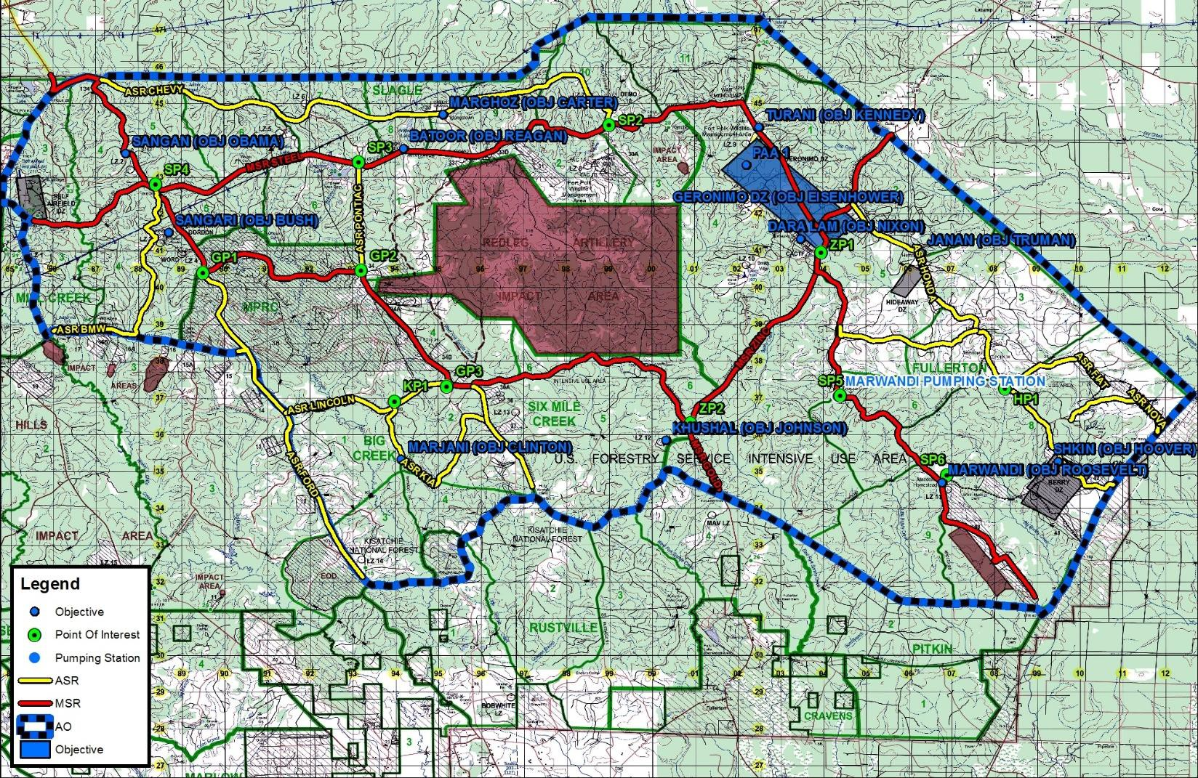
LTP TTP
Reference: FM 3-13
IO Mission Analysis - PMESII-PT Analysis
AO BEAR POPULATION CENTER ASSESSMENT
I
P
M
I E
S
SAPA Control
I
P
M
I
P
M
I
S
E
I E
S
I
P
M
SAPA Control
I
S
E
SAPA Strongpoint
I
P
M
I
P
M
Ethnic Persian Enclave
I E
S
I
S
E
I
P
M
SAPA Control
I
P
M
I
S
E
I
S
E
SAPA Control
I
P
M
Ethnic Persian Enclave
I
S
E
UNKNOWN
Provincial Capital Municipal Town
Non-municipal Town
PERMISSIVE
UNCERTAIN
HOSTILE
43

Slide 49
MDMP Step 3:
Course of Action Development
44

Slide 50
Enemy Vulnerabilities
As of: 16 April 2019 .v2
Enemy Vulnerabilities | Whose Fight (Div / Bde / Bn) | Exploitation (What we can do to the enemy) | Exploit When: (Phase / Date / Time)
Movement & Maneuver
EN in fixed positions tied to defense of the obstacle; largely tied to roads due to marshy off-road conditions. | BN | Envelope OBJ Benz from a direction his defenses are not facing and soften with IDF to limit his maneuverability | Phase 2: Movement to Assault Positions
EN already atritted below 75% strength; reserve support is no more than a company in 6 hours. | BDE | Have JTF Identify and defeat enemy intentions west of Sabine River IOT isolate Benz and Audi | Phase 3: Assault of OBJs Audi and Benz
Fires
2S19 BN must position between PL BLUE and PL GREEN to range OBJ KNIFE with chem fires. | Division | DIV targets 2S19 BN (HPTL #2) and attacks with AI and HIMARS | Phase 1: Recon
ZSU-23-4s operate visual detection mode (no radar capability). | BCT | ZSU-23-4 positioned within 2km of likely LZs – Shadow and AH-64 find and target. | Phase 1: Recon
Intelligence
EN relies heavily on FM communication between recon elements and main body forces. | Div | Conduct EW to cut off EN information flow between recon and main body forces. | Phase 2: Assaults on OBJs Audi and Benz
Mission Command
EN communication platforms are easily identifiable. | Div | Use EW for jamming and DF to locate critical EN C2 nodes. | All Phases
Protection
EN has limited counter mobility capability to employ complex obstacles limits their ability to slow / attrit advancing forces. | BCT | Task organize mobility assets to rapidly clear obstacles on primary routes | Phase: 2 and 3 seize Objs Audi and Benz
EN had limited engineer survivability assets to construct prepared positions to protect key MC and AD assets | BCT | Target MC nodes and armor with fires and attack aviation | Phase: 1 Recon
SAPA Offensive chemical capability limited to non- persistent (CS/Chlorine). |  | MOPP Ready posture maintains higher tempo to rapidly secure objs and reduce likelihood of chemical use | Phase: All
 | BCT
Sustainment
N/A
45

Slide 51
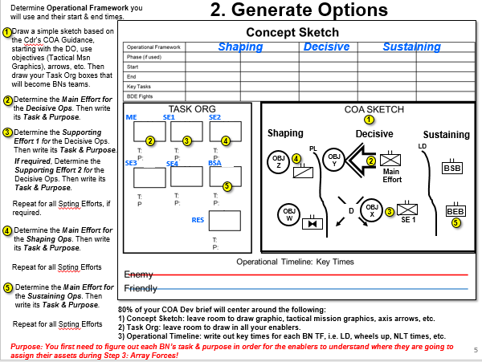
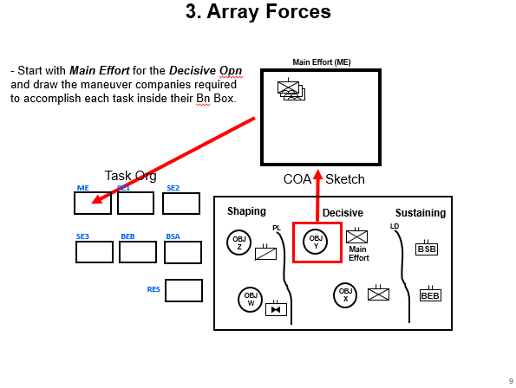
Recommended TTP
Start with a small planning team, i.e. XO, S3, FSO, S2, and A/S3s to complete
Steps 1: Assess Relative Combat Power, Step 2: Generate Options, and array maneuver companies (normally done in Step 3: Array Forces).
Purpose: This will allow a small group of planners to quickly lay the foundational information
required to build each course of action before we bring in the entire staff.
46a

Slide 52
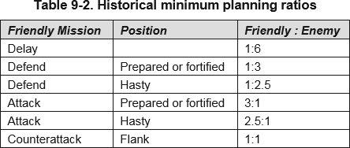
1. Assess Relative Combat Power
- Quickly compare Enemy maneuver company equivalents against Friendly maneuver company equivalents; apply currents strengths and historical planning factors.
Purpose: Do we have enough combat power to even begin planning?
OBJ DAGGER
OBJ BAYONET
VS
(-)
VS
EN in Prepared Defense
EN in Hasty Defense
47

Slide 53
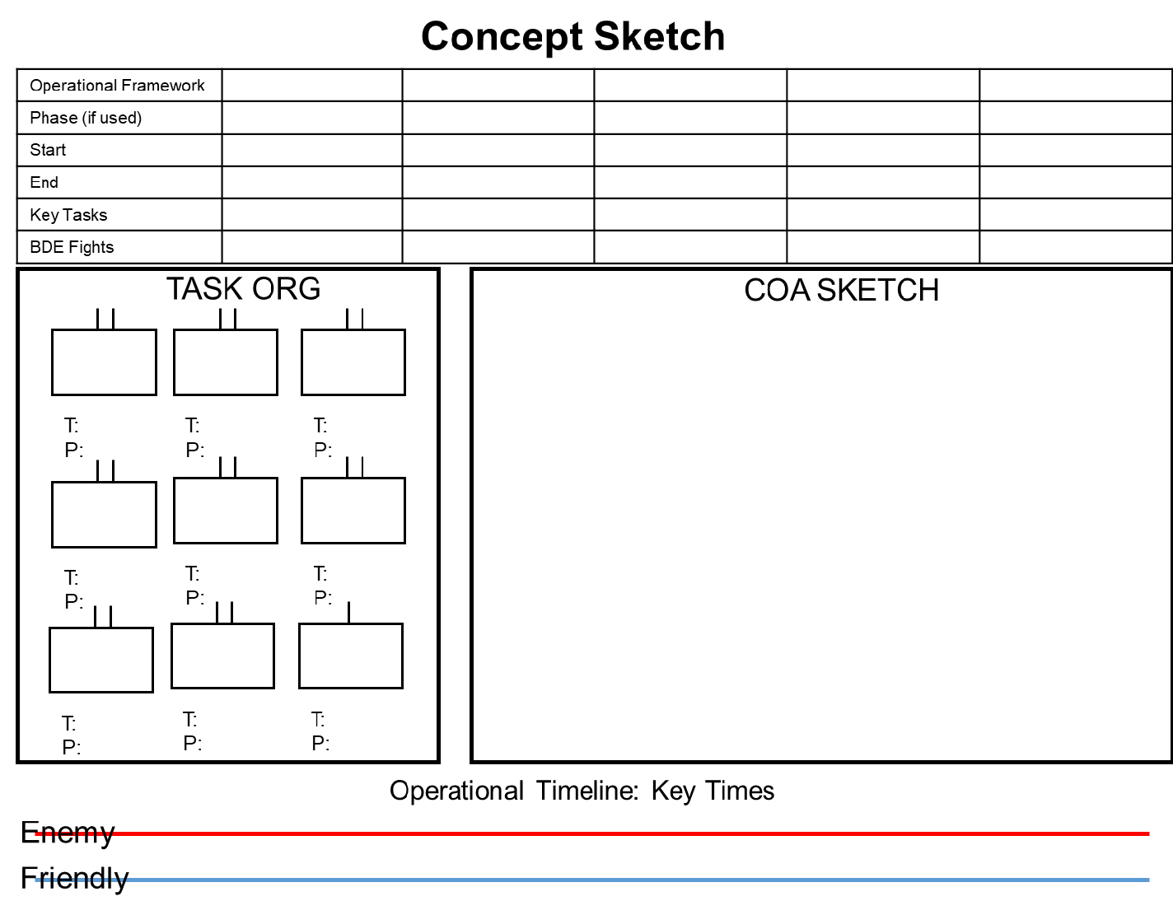
2. Generate Options
Determine Operational Framework you
will use and their start & end times.
Draw a simple sketch based on the Cdr’s COA Guidance, starting with the DO, use objectives (Tactical Msn Graphics), arrows, etc. Then draw your Task Org boxes that will become BNs teams.
Determine the Main Effort for
Shaping Decisive Sustaining
the Decisive Ops. Then write its Task & Purpose.
3 Determine the Supporting Effort 1 for the Decisive Ops. Then write its Task & Purpose.
If required, Determine the Supporting Effort 2 for the Decisive Ops. Then write its Task & Purpose.
ME
SE1
SE2
1
Decisive
Shaping
Sustaining
LD
2
3
4
PL
SE3
BSB
BSA
OBJ Z
4
OBJ Y
2
Main
BSB
5
Effort
Repeat for all Spting Efforts, if required.
Reserve
D
OBJ X
BEB
OBJ
3
W
SE 1
5
4
Determine the Main Effort for the Shaping Ops. Then write its Task & Purpose.
Repeat for all Spting Efforts
5
Determine the Main Effort for the Sustaining Ops. Then write its Task & Purpose.
80% of your COA Dev brief will center around the following:
Concept Sketch: leave room to draw graphic, tactical mission graphics, axis arrows, etc.
Task Org: leave room to draw in all your enablers.
Operational Timeline: write out key times for each Battalion, i.e. LD, wheels up, NLT times, etc.
Repeat for all Spting Efforts
Purpose: You first need to figure out each BN’s task & purpose in order for the enablers to understand where they are going to assign their assets during Step 3: Array Forces!
48

Slide 54
3. Array Forces
Shaping
Decisive
Sustaining
Shaping
BSES4^{PL}
A
Decisive
Sustaining
LD
_{OBJ} OBJ
_{Z} Y
Main
Effort
Focus Area for Step 3
OBJ
BSB
OBJ W
D
X
BEB
SE 1

Slide 55
3. Array Forces
- Start with Main Effort for the Decisive Opn and draw the maneuver companies required to accomplish each task inside their Bn Box.
Main Effort (ME)
Task Org
COA Sketch
ME
SE1
SE2
Shaping
Decisive
Sustaining
LD
SE3
BSA
PL
OBJ Y
BEB
OBJ
Z
Main Effort
BSB
RES
OBJ X
BEB
OBJ W

Slide 56
3. Array Forces
- Start with Main Effort for the Decisive Opn and draw the maneuver companies required to accomplish each task inside their Bn Box.
Spt Effort 1 (SE 1)
- Go to the Supporting Effort 1 for the Decisive Opn and draw the maneuver companies required to accomplish each task inside their Bn Box.
Task Org
COA Sketch
ME
SE1
SE2
Shaping
Decisive
Sustaining
LD
SE3
BEB
BSA
PL
OBJ OBJ
Z Y
Main Effort
BSB
RES
OBJ X
OBJ W
BEB
SE 1

Slide 57
3. Array Forces
- Start with Main Effort for the Decisive Opn and draw the maneuver companies required to accomplish each task inside their Bn Box.
Supporting Effort (SE2)
- Go to the Supporting Effort 1 for the Decisive Opn and draw the maneuver companies required to accomplish each task inside their Bn Box.
- If required, Determine the Supporting Effort 2 for the Decisive Ops. Repeat steps
- Next go to Main Effort for the
Shaping Ops. Repeat steps.
Task Org
ME SE1
COA Sketch
SE2
Shaping
Decisive
Sustaining
LD
SE3
BEB
BSA
PL
OBJ OBJ
Z Y
Main Effort
BSB
- Repeat for all Supporting
Efforts for the Shaping Ops.
RES
OBJ W
OBJ X
BEB
Next go to Main Effort for the
Sustaining Ops. Repeat steps.
Repeat for all Supporting Efforts.
Repeat for the Reserve.

Slide 58
3. Array Forces
Once you have assigned all the maneuver companies it is time to bring the staff back into the process.
The staff go to their assigned COA Team Lead area. Their COA Team Leader will brief them on each unit’s task and purpose and why they assigned the number of maneuver companies against each objective.
Now start over with the decisive operations main effort and follow the same steps as before and this time each enabler lead will determine which unit they will assign their enablers.
Task Org
COA Sketch
Decisive
ME
SE1
SE2
Shaping
Sustaining
LD
PL
OBJ Z
OBJ Y
SE3
BEB
BSA
Main Effort
BSB
OBJ W
D
OBJ X
BEB
RES
SE 1

Slide 59
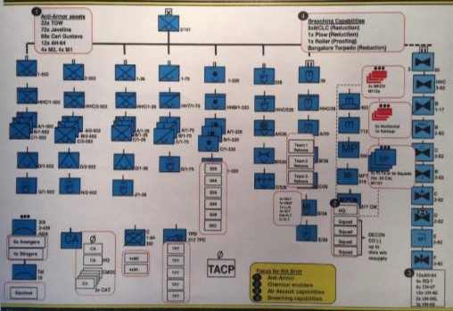
3. Array Forces
- Start with Main Effort for the Decisive Opn and
add the enablers required.
Main Effort (ME)
MI
- Go through all the remaining Battalions in priority order
as before and assign all your enablers.
CA
- As you assign each enabler you mark them off your task org chart to ensure you have accounted for every unit.
Task Org
ME SE1 SE2
COA Sketch
Shaping
Decisive
Sustaining
LD
SE3
BSA
PL
OBJ Y
OBJ Z
Main Effort
BSB
X
X
X
BEB
RES
OBJ W
OBJ X
BEB
Enablers: During this step take good notes on the following:
Based on the BN’s task & purpose decide what size element you are going to place under that BN’s control.
Decide your elements task & purpose.
Decide the command / support relationship of that element to the BN: OPCON, TACON, ATTACH
Draw your element’s symbol inside each of the Bn’s Task Org Box.
**You will need all this critical information during the next MDMP Step 4: COA Analysis (War Gaming)!

Slide 60
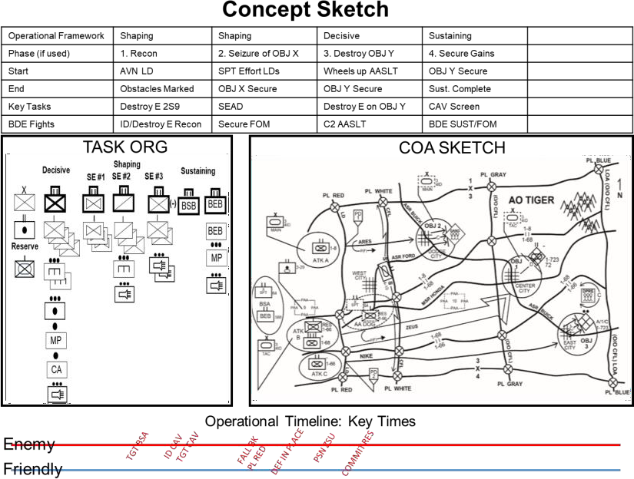
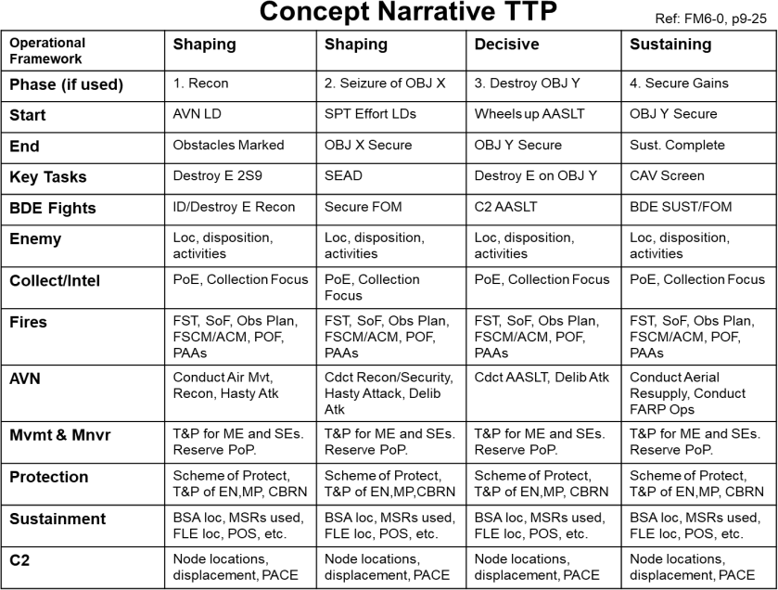
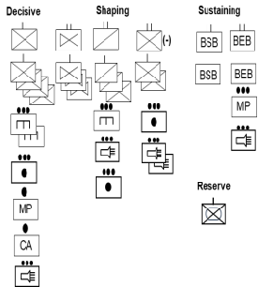
4. Develop a Broad Concept
- Another way of saying this is “Integrate & Synch each WfF!” aka…it’s the start of your concept statement!
Now that you have completed your Concept Sketch and your Task Organization your focus moves to completing your Concept Narrative and your Operational Timeline!
A complete COA covers the 14 items outlined in 6-0 plus LTP’s recommended extras
Purpose
Accepted risk
ID critical friendly events & transitions between phases
Decisive Operations
Shaping Operations
Sustaining Operations
Reserve
Recon & Security Operations
Assignment of Subordinate AOs
Scheme of Fires
Info themes and messages
Deception
Control Measures (Ops Graphics)
Friendly & Enemy Timelines
---------- LTP Extra Checks ----------------
Write Scheme of Intel Collection
Write Scheme of Fires
Write Scheme Movement & Maneuver
Write Scheme of Protection
Write Scheme of Sustainment
Write Scheme of Command & Control
Assign all enablers Tasks & Purpose
Assign all enablers a Command / Spt Relationship
WfF Leads: This is where you have to write your portion of the Concept Narrative Statement
in the form of a “Scheme of .” This shows how your WfF will support the overall concept. ₅₅

Slide 61
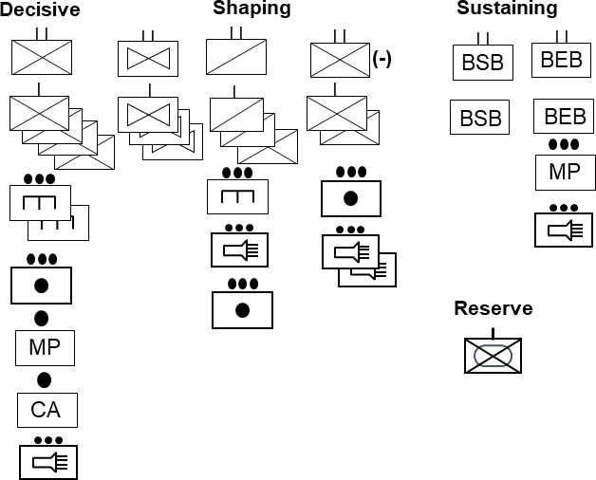
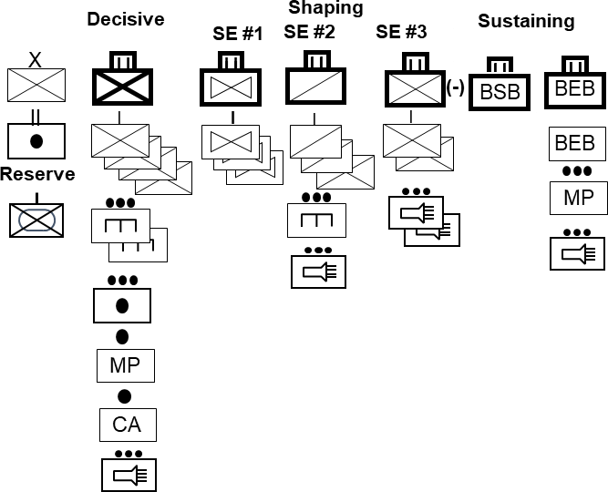
5. Assign Headquarters
I I
I I
How to do it:
Create a Task Organization by assigning HQs to grouped forces.
Determine which Battalions will need to be a Task Force & which ones will remain pure.
A HQs controls at least two subordinate maneuver units (but not more than five).
Consider HQs requirements for all phases
Consider special command requirements...PZ Control, Ground Movement, AATFC, etc.

Slide 62
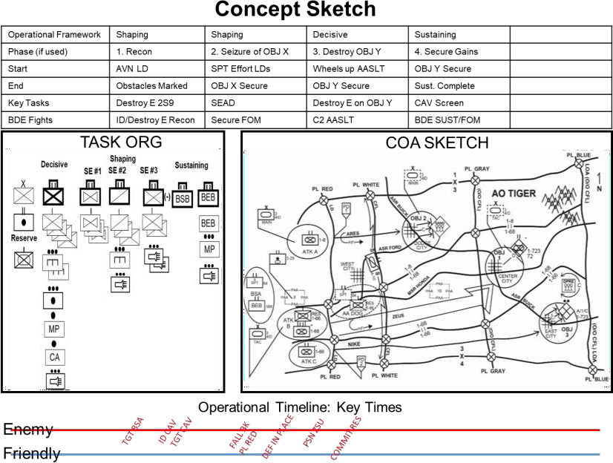
6. Prepare COA Sketch and Statement
Good News! You accomplished this already by starting with a template to fill in.
62
Items to Consider:
If you use the map as your background, and do your COA Sketch on acetate, you’ll have an overlay you can lay on the white board, that helps you to consider impacts of terrain, time and space – before war-gaming.
At this point your graphics are 75% complete.
S3s must transfer this work into a written COA Statement at some point.

Slide 63
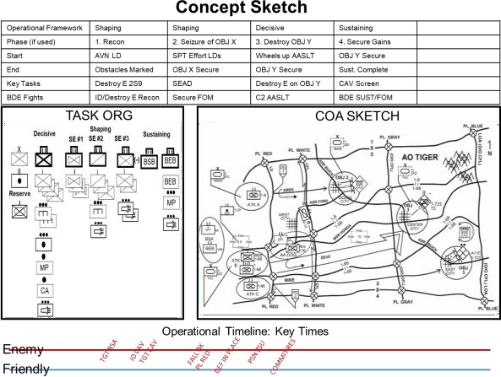
7. Conduct a COA Briefing
Potential Briefing Agenda
Mission Statement
Commander’s Intent
Orient to sketch & control measures
Updates to IPB, EN COAs
PIR/NAI Matrix (might be a handout)
Scheme by Opn or Phase: EN, Collect,
Fires, AVN, M&M, C2, Prot, Sust.
COA Evaluation
Updated Facts/Assumptions
Commander’s Guidance
Items to Consider:
Recommend you save time and brief straight off of your dry erase board products.
Check your work against the FASD Test, Commander’s Guidance, Enemy
Vulnerabilities Matrix, and the Brigade Fights before you brief.
Save time to rehearse.
Time permitting, put a copy of the COA paragraph in Commander’s hands.
Remember – this becomes the OPORD Concept of Operations paragraph.
57a

Slide 64
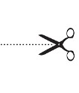
AGADAD Smart Card “Cut Outs”
AGADAD Smart Card
Step 1: Assess Relative Combat Power:
- Make rough estimate of force ratio of maneuver units two levels below your echelon. “Compare what you need, versus what you have!
- BCT Staffs: Compare U.S. maneuver companies against Enemy Companies.
- You can use COFMs (Correlation of Forces & Means)
Step 3: Array Forces:
Determine the relative combat power required to accomplish each task. This is where you start building your Task Organization!
Array forces two levels below their echelon.
Shaping
Decisive SE #1 SE #2 SE #3
Sustaining
X
I I
I
(-)
BSB
BEB
II
= =
+
MP
OR
(-)
You will need 1 x INF Bn and three extra INF Companies
Reserve
1 x EN INF CO You will need
in Defense 3 x Inf Companies (3 to 1 Ratio)
1 x EN INF Bn (-)
in Zone
- Look for friendly and enemy vulnerabilities.
Step 2: Generate Options:
- A good COA can defeat both the Enemy’s MLCOA & MDCOA!
1) Determine Operational Framework you will use.
* Recommend using Shaping-Decisive-Sustaining
PL
MP
CA
PL
Decisive
LD
Shaping Sustaining
Step 4: Develop a Broad Concept:
Another way of saying this is “Complete the COA” or “Integrate & Synch each WfF!” aka…it’s the start of your concept statement & sketch!
Go through your 14 concept requirements.
Main Effort
Spt Effort
OBJ X S
Spt Effort
T:
P:
T:
P:
T:
P:
Spt Effort
D OBJ Y
Main
Effort
Purpose
Accepted risk
ID critical friendly events &
transitions between phases
Decisive Operations
Shaping Operations
Sustaining Operations
Reserve
Recon & Security Operations
Deception
Control Measures (Ops Graphics)
Friendly & Enemy Timelines
---------- LTP Extra Checks ----------------
Write Scheme of Intel Collection
Write Scheme of Fires
Write Scheme Movement & Maneuver
Write Scheme of Protection
T:
P:
T:
P:
Main Effort
T:
P:
Determine the Main Effort and Supporting Effort for each of the Decisive, Shaping, and Sustaining Operational Framework.
Determine Task and Purpose for each subordinate unit, defined as down to Battalion level starting with the Decisive Operation, then Shaping, and then Sustaining.
Determine Essential Task for the decisive, shaping, and sustaining.
19. Write Scheme of Sustainment
9. Assignment of Subordinate AOs 20. Write Scheme of Command & Control
Scheme of Fires
Info themes and messages
Deception
Assign all enablers Tasks & Purpose
Assign all enablers a Command / Spt Relationship
58

Slide 65
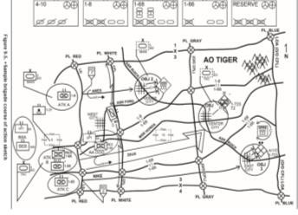
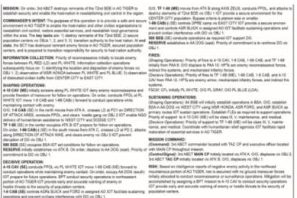
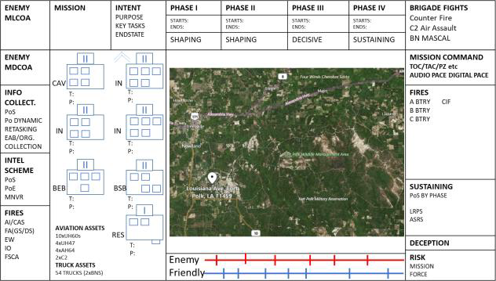
AGADAD Smart Card “Cut Outs”
Step 5: Assign HQs:
Doctrine tells you to create a Task Organization by “assigning HQs” to grouping forces.
A common TTP is more than likely the BCT Cdr will assign his Battalions to each mission based on each Bn Cdr’s personalities, level of unit’s training, unit’s experience, etc.
Remember a HQs controls at least two subordinate maneuver units (but not more than five).
Step 6: Develop COA Statement & Sketch:
- You can make a separate Concept Sketch and Concept Statement as outlined in FM 6-0, C2, p. 9-24 and p.9-25
Decisive
Shaping SE #2
Sustaining
SE #1
SE #3
X
I I
I I
I I
I I
I I
I I
(-)
BSB
BEB
- Or use the TTP where you join the two products on one dry erase board with the “Concept Sketch” in the middle and the “Concept Statement” is distributed around the outside of the Sketch.
II
I
I
I
I
BEB
Reserve
MP
MP
CA
Step 7: Conduct COA Brief:
- Recommend you save time and brief straight of your dry erase board products you developed during Step 6.
59

Slide 66
Building Combat Power “TTP”
Items to Consider:
The average Brigade Combat Team has between 1200 to 1400 pieces of rolling stock of equipment.
The average Brigade Combat Team has between 4500 to 5000 personal assigned.
On average 90% of the Brigade’s combat power is non-maneuver elements.
It typically takes 3 to 5 days to get all the Brigade’s equipment into the maneuver area.
O/C-T Observed Trends | Cost | Fix
Staffs focus only on how they will deploy the maneuver elements when developing a tactical plan. They wish away the remaining Brigade’s non-maneuver assets and how they will flow into the maneuver area. | Due to the lack of detailed planning for the flow of the non-maneuver elements into the maneuver area the Bde quickly becomes overwhelmed and the tactical plan quickly becomes derailed. | Staffs should plan in enough detail on how “all” the BDE’s vehicles and personal are going to flow into the maneuver area in order to provide the Cdr flexibility, predictability, and best supports the tactical plan.
Bde Staffs do not establish a priority for their vehicles and equipment to move from the ISB into the maneuver area. | The Cdr cannot make key decisions based on the lack of knowledge of when key equipment will enter into the maneuver area. | Units need to create a Priority Vehicle Plan (PVL) that supports the build up of combat power IAW the tactical plan.
Units fail to task the appropriate level HQs to command and control the movement of vehicles and personal. | Convoys, fixed wing load plans, and air assault operations are not properly C2 which results in disjointed movements and derails the Cdr’s tactical plan. | Units should task a Bn level HQs to be responsible for each of the following key movements; air assaults PZ Ops, convoy operations, and air land operations.
Staffs cannot communicate in detail or with certainty when key pieces of equipment will arrive by hour or on which day. | The Cdr cannot not make informed decisions based on he does not know when certain critical pieces of equipment and vehicles will arrive into the maneuver area. | Tracking tools should be developed that lays out the percentage of combat power that is arriving with each convoy, air land, air assault, our airborne drops.
Questions to ask yourself:
Who is tasked to C2 the entire air assault’s PZ operations? Example: Who is responsible to plan this portion (PZ Ops) of the BCT plan, who is the PZ Operations Officer, who is providing the chalk guides, establishing the heavy PZ and light PZ, sling load ops, managing frustrated cargo and the bump plan, who has the authority to execute the bump plan, receiving returning causalities on A/C, etc.
Who is tasked to C2 all convoy operations? Example: Who is responsible to plan this portion of the BCT plan, establishing the ISB marshalling and staging area, lining up convoys in the proper order, controls convoys SP times from the ISB, etc.
Who is tasked to C2 all the air land operations? Example: Who plans this portion of the BCT plan, who builds the PVL, who is in charge at the
APOD, who builds the load plans, prep vehicles, lines up the vehicles in priority, executes the bump plan, manages frustrated cargo, receives the vehicles on the flight landing strip, up loads and down loads classes of supply, manages the CDS drops, who is in charge at the airfield in the maneuver area, etc.
60

Slide 67
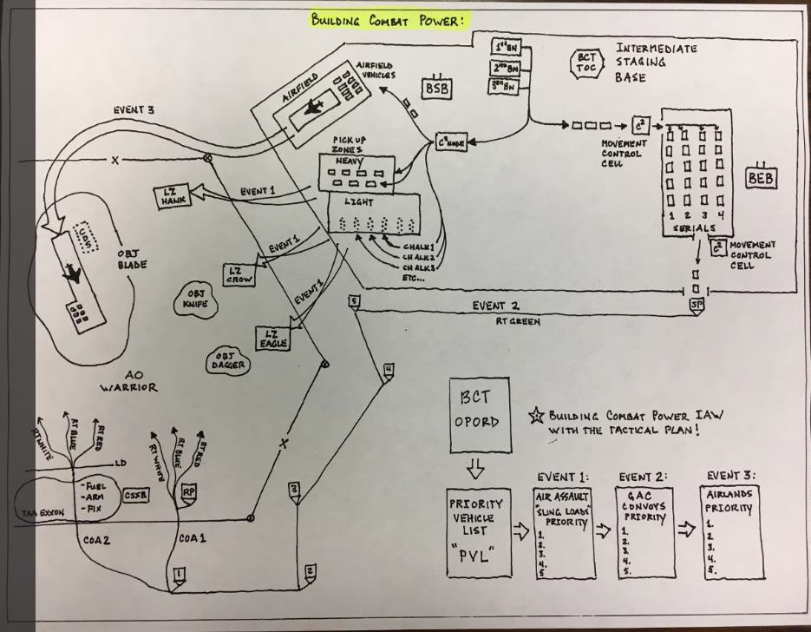
Command & Control of Building Combat Power “TTP”
The BSB is tasked to C2 all the components of the air assault PZ Operations and fix wing landing operations.
The BDE XO is located inside the TOC fighting the BDE in conjunction with the BDE TAC Forward.
The BEB is tasked to C2 all the components of the convoy operations from the ISB to the maneuver area.
The BDE Staff should build a Priority Vehicle List (PVL) which outlines how the BDE will flow combat power into the maneuver area IAW the tactical plan.
The PVL should layout in detail the priority of vehicles for the air assault, fix wing, and convoy operations. Also for airborne operations if conducting a airborne insertion.
61
You need to consider do we task the CSSB to set up a Tactical Assembly Area (TAA) in order to conduct a FLE or ROM capability for our convoys.

Slide 68
Building Combat Power
Brigade Staff Responsibilities:
Developing a Priority Vehicle List (PVL) for the Tactical Road March
(TTP)
Calculate:
Based on 1200 vehicle rolling stock in the Brigade.
Only 20 vehicles allowed per convoy serial.
Directed speed of 35 mph.
From first convoy SP from ISB to last convoy RP into box
what is the total number of hours it will take to get 1200 vehicles into the box.
20
Vehicles
20
Vehicles
20
Vehicles
20
Vehicles
20
Vehicles
20
20
20
Vehicles
20
Vehicles
20
Vehicles
20
Vehicles
Vehicles Vehicles
Based on BCT Cdr’s Tactical Plan:
Develop the BCT priority flow for vehicles into the box.
Task a Bn, i.e. BEB to C2 Bde vehicle movements out of ISB
Task/Assign a Battalion to each serial.
Task a Battalion to assign a Serial Cdr for each Serial.
Build a Combat Power availability timeline.
Build Convoy EXCHECK (SPs times, RP Times, etc).
Serial 1
Serial Serial Serial
2 3 4
Serial Serial Serial
5 6 7
Serial Serial
8 9
Serial
59
Serial
60
Etc..
2nd Bn, 22nd INF
(Main Effort)
1st Bn, 87th INF (Spting Effort #1)
23 1100 Jan 24 Jan
1st Bn, 32nd INF (Spting Effort #2)
10th BSB
22 Jan
Times used are for example only
22 1000 Jan 23 Jan
24 2020 Jan
25 Jan
22 0400
Serial 4 SP
22 2200
Serial 21 SP
23 0400
Serial 32 SP
60% Cbt Pwr In the Box
Etc..
24 1400
90% Cbt Pwr In the Box
22 0300
Serial 1 SP
22 0500
Serial 7
SP
20% Cbt Pwr In the Box
Etc..
Serial 45 SP
Battalion Staff Responsibility
20
AT- A Co HQ 14
20
AT- B Co HQ 16
20
AT- C Co HQ 21
Calculate:
Etc.
Etc.
Etc.
Based on 60 vehicle rolling stock in the Battalion.
Only 20 vehicles allowed per convoy.
Directed 35 mph.
From first convoy SP from the ISB to last convoy RP into the box
₅ AT- HQ
₄ A/2-22 HQ 42
5
2/22 HQ 2
B N
5
C 2/22 HQ 35
₄ 2/22 HQ 3
3 2/22 HQ 6
T A C
₄ C 2/22 HQ 31
3 C/2-22 HQ 6
what is the total number of hours it will take to get 60 vehicles into the box.
3
A/2-22 HQ 6
2
*AT- A Co HQ 13
2
*AT- B Co HQ 6
2
*AT- C Co HQ 24
Based on the Bn Cdr’s Tactical Plan:
Based on the assigned serial number of convoys by Brigade.
Develop the BN priority flow for vehicles into the box.
Assign Co vehicle bumper numbers to your assigned serials
Assign Serial Convoy Cdrs for your serials
Push bumper numbers back up to BCT S4 / SPO for EXCHECK.
* Denotes Convoy Cdr
1
AT- A Co HQ 12
1
AT- B Co HQ 15
1
AT- C Co HQ 20
Serial 1
A Co / 2-22
(Main Effort)
Serial 2
B Co / 2-22
(SE #1)
2nd Bn, 22nd INF (Main Effort)
Serial 3
C Co / 2-22 (SE #2)
Version 4
62

Slide 69
Building Combat Power “TTP”
63

Slide 70
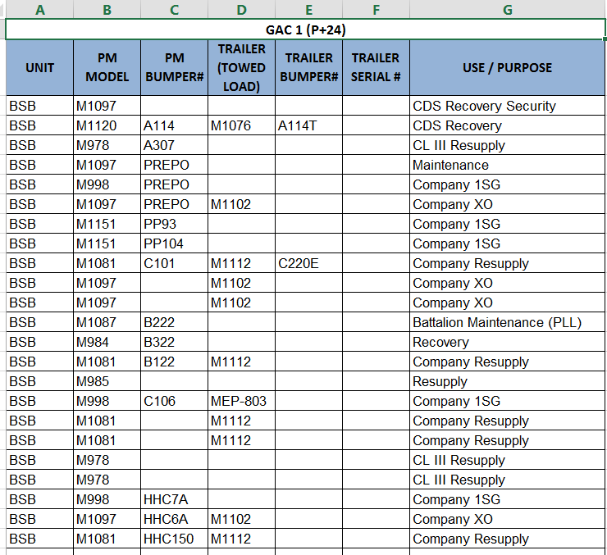
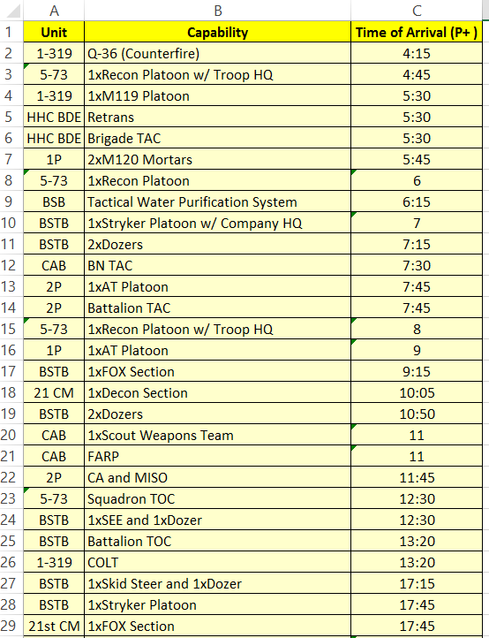
Example Building Combat Power “TTP”
GAC PVL Capabilities by Time
These are example Priority Vehicle Lists from previous units.
There is no doctrinal format for how to build these products.
Priority of Air Lands
64

Slide 71
MDMP Step 4: COA Analysis (War Game)
65

Slide 72
War-Gaming “TTP”
LTP TTP
FM 6-0, Change 2
O/C-T Observed Trends | Cost | Fix
Staffs fail to identify the Brigade fights or Brigade level critical events to war game. | The BDE level staffs waste valuable time war gaming generic / non-critical events or they waste time by war gaming a Battalion level event or even a company level critical event. | Prior to starting the war gaming process the Cdr and the staff need to decide on what the Brigade fights are and ensure those are the critical events they will focus the war gaming process.
Staffs fail to properly conduct an analysis on the time available vs the number of Brigade level critical events they intend to war game or they fail to prioritize their critical events. | Staffs fail to complete the war gaming process because they focus on too many events & run out of time. Staffs fail to war game their decisive action because they start war gaming other less important events first. | Staffs should plan that one Brigade level critical event to war game averages around 20 to 25 minutes. FM 6-0, C2: “The amount of detail or the number of everts to war game depends on time available.”
Staffs try to record every critical event for each Action, Reaction, and Counteraction. Some staffs even have three separate columns for each action, reaction, counteraction on their Synch Matrix. | A massive amount of time is wasted trying to record everything discussed for each action, reaction, and counteraction. This is not a doctrinal requirement. | The action-reaction-counteraction is a dialogue cycle. Record the first “action” based on who has the initiative, but the “reaction” and “counteraction” is a discussion among the staff. The Synch Martix records the “results” of a war game…not everything discussed.
Staffs “display” their Synch Matrix on a screen and wait for the recorder to type in all the staffs decision / discussion points / comments. | A massive amount of time is wasted and the entire process is slowed down waiting on the recorder to capture what is being said on the Synch Matrix. | Print out your synch matrix in hard copy for the staff to use. Have your recorder on a separate lap top filling out the synch matrix. (See The Process Slide.)
Staffs only communicate then record a “task” and then “purpose” when called on for an critical event. | Valuable information is omitted, not discussed, and not recorded. The recorder wastes time reengaging the staff later on to fill in the synch matrix. | Issue guidance out to the staff on the minimum information they are expected to brief for each event and to record. *See Synch Card
The synch matrix is a generic synch matrix that does not force the staff to review critical events or assist them in building other fighting products. | Critical Brigade level events are not addressed or the process does not assist in building other products. | Tailor your synch matrix structure / format to assist the staff in building other fighting products, i.e. DSM, EXCHECK, script for the BDE rehearsal during the war gaming process. *See Synch Matrix
Bde Staffs lay their map with graphics and friendly and enemy icons flat on a table. | The entire Bde Staff cannot visualize in time and space where icons are on the map and cannot see the graphics. Therefore they cannot provide quality input on how their capability will support the fight. | If possible have a blow up of the map and have the map upright for the entire staff to visualize what is occurring during the battle.
Key Staff Positions & Responsibilities:
Information Manager (non-doctrinal): Responsible for managing the Staffs Synch Cards. He ensures they are properly filled out for clarity and content, ensures the cards are placed on the Synch Matrix in the correct column and time and space. He maneuvers the cards between the recorder and Synch Matrix. He coordinates between the staff and the recorder when Synch Cards are not to standard. Staffs get the best results when they use the Ops SGM or someone with his level of experience as the Info Manager.
Recorder: Responsible for capturing all the staffs input during the war gaming process on a lap top.
66

Slide 73
War Gaming Gather the Tools Check List:
- All WfF reps and/or staff reps must have a clear plan for how they will employ their capabilities in time and space across the COA: format could be written notes, sync matrix, sketch, etc.
XO:
*CCIR Product
*DSM
Roll Call Cheat Sheet
EN Vulnerabilities Product
Intel WfF:
S2:
Running Estimate
EN Vulnerabilities Product Icons:
EN Forces
EN Fires & ADA Range Fan MA WfF Quad Charts
*ECOAs SITEMPs & Statements
Info Collection Manager: Running Estimate Scheme of Info Collection Icons: EAB IC Resources
*NAI Overlay
Info Collection Matrix
*Initial Info Collection Synch Matrix
MI CO CDR:
Running Estimate Icons: MI CO Assets Scheme of Intel
Movement & Maneuver WfF:
S3: Task Org
Concept Sketch
Operations Timeline
Enemy Vulnerabilities Product
A/S3:
Synch Matrix (hard copy blown up) Operations Map
*Updated Graphics
DSM
Draft EXECUTION Matrix
Reserve Icon
MA WfF Quad Charts COFMs
LNOs:
Running Estimates Unit Icons
BAO:
Running Estimates
Draft AASLT / ABN scheme of maneuver
Reverse WfF Worksheets
Fires WfF:
FSO:
Running Estimate
* Draft TSM (HPTL /TSS / AGM) Draft TLWS
Icons For:
BCT CFL Markers Div CFL Markers
Firing Units (BTRY / PLT) and WLR (Q53 / Q36 / Q50)
Range Fans:
120mm Mtr/105mm/155mm/HIMARS/ Q53/Q36/Q50
Joint Munitions Effects Table or Equivalent Chart
COFMs
Reverse WfF Worksheet MA WfF Quad Charts
EW:
Running Estimate Draft AEW requests
CA:
Running Estimate
Civil Considerations Analysis
PAO:
Running Estimate Themes and Messages
Draft PAG / Soldier Talking Points
PSYOPS:
Running Estimate
Protection WfF:
WfF Lead
T&P and C/S relationship for each Protection asset from COA DEV Draft Scheme of Protection Protection Prioritization List
EEFI list
Risk Assessment Reverse WfF Worksheets
Protection Unit/Asset Icons MA WfF Quad Charts Draft CAL / DAL
ABE:
Running Estimate
Bridging icons Bridging/Breaching time analysis
CBRN:
Running Estimate Down Wind Templates
Decontamination Time Tables
ADA:
Running Estimate
ADA Icons
ADA Protection Rings Draft Unit Airspace Plan
MP:
Running Estimate Route/Area Security Analysis
Sustainment WfF:
S4:
Running Estimate Movement Tables (GAC) Icons:
FLE icons CSSB icons
Time Distance Tables Fuel Consumption Rates Reverse WfF Worksheets MA Quad Charts
S1:
Running Estimate
Causality Estimate Calculator
MEDO:
Running Estimate
Chaplain:
Running Estimate
Command & Control WfF:
S6:
Running Estimate C2 Icons:
TOC TAC
Assault CP Retrains
Reverse WfF Worksheets
MA WfF Quad Charts
SPEED Program analysis of comms capabilities
Answer Key:
* = Fighting Product
66a

Slide 74
Battlefield Framework |  |  | Shaping Operations |  | Shaping Operations
Event |  |  | C2 Air Assault |  | Critical Event: Air Assault “No Go”
Date/Time |  |  | Air Assault Begins: 070200JUN | Air Assault Complete 070400JUN | Truck Infil Begins 070400JUN | Truck Infil Ends 071600JUN
Enemy Actions
Decision Point |  |  | DP 1: Execute Air Assault |  | DP 2: Execute Truck Infil
CCIR
- PIR
- FFIR
- EEFI
I N T E L | Collection Manager
 | MICO
F I R E S | AI /CAS
 | FA (GS / DS)
 | EW / CEMA
 | CA
 | PSYOP
 | PA
 | FSCM / ACM
Movement & Maneuver |  | CAV
 |  | 2-22 INF
 |  | 1-87 INF
 |  | 1-32 INF
 |  | Reserve
 |  | AVN / BAE
Synch Matrix Format
TTP
(Page 1 of 2)
Staffs fail to realize that building the Synch Matrix is part of “Gathering the Tools” outlined in FM 6-0, C2. They do not take the time to tailor the Synch Matrix for their specific mission, i.e. offensive vs defensive operations, air assault missions, action on objectives, etc.
More importantly they wait to the last minute to assign someone to create the Synch Matrix or fail to realize the amount of time it takes to create and print it out.
You start building your Synch Matrix at Receipt of Mission.
67

Slide 75
FA BN | A Btry
 | B Btry
 | C Btry
 | Ctr Fire
 | GS/R FA
P R O T E C T I O N | EN
 | MP
 | CBRN
 | ADA
 | EOD
S U S T A I N M E N T | MAINT
 | TRANS
 | SUPPLY
 | Field Services
 | Distro
 | HSS
 | Pri of Supply
 | Pri of Support
 | CASEVAC
Command & Control | Main CP
 | TAC CP
 | CMD / CTRL
 | Tasks / Retrains
 | PACE Higher
 | PACE Lower
 | Risk
Synch Matrix Format TTP
(Page 2 of 2)
68

Slide 76
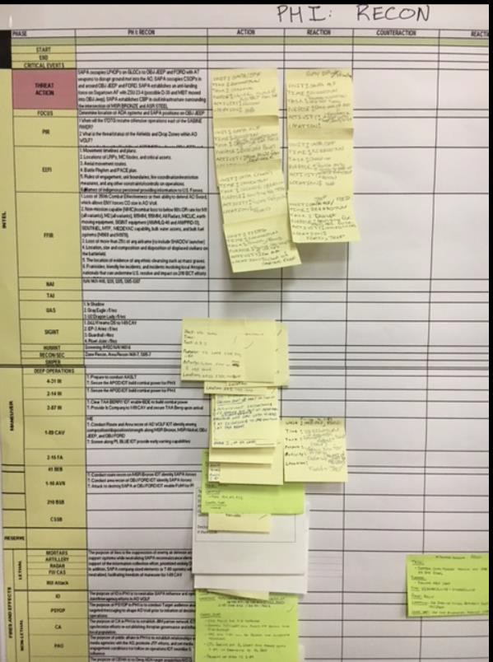
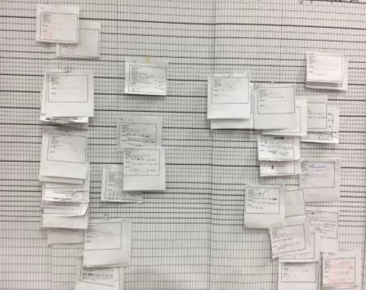
The War Gaming Tools: Synch Cards
LTP TTP
FM 6-0, Change 2
The following are examples of the Staff’s Synch Cards. The staff uses these cards to record and provide information on how their staff function will support the course of action. Once the cards are read to the group and approved the XO, they are then taped to the synch matrix.
These cards can be mass produced with the headers (See Synch Card template below) and filled out either in advance or during the war gaming process.
The staff needs to understand the information they are writing on their Synch Cards will become a specified task in the order. Therefore they need to provide clarity in their writing. Also once called upon by the XO they read the card exactly…you are not telling a story!
The XO and S3 will filter the staffs information as they read their Synch Card to the group. If the staff writes them correctly you will have the 80% solution for the order once you are done. This is especially true if the XO and S3 make corrections to the staff Synch Cards during the war gaming process. This saves the XO/S3 valuable time during Step 7 Orders Production when they have to read the order before it is published.
If possible the XO, S3, and S2 should have assistant staff members filling out their Synch Cards. This will allow them to be engaged and visualize the flow of the operation, given the force’s strengths and dispositions, the enemy capabilities, and remain focused on the Brigade fights.
Staff Section:
Unit:
Phase:
DTG/Time:
Location/Grid:
Task:
Purpose:
Activity:
Staff Section: A/S3
Unit: 2-22 INF
Phase: Decisive Operations (Seize OBJ DAGGER)
DTG/Time: 23 01000 AUGUST 2018
Location/Grid: VG 123456
-Task: Destroy Mech PLT on OBJ DAGGER
Purpose: In order to allow the passage of the main effort (1-87INF) onto OBJ BAYONET.
Activity: N/A
Staff Section: ENG
Unit: 7th BEB, 10th MTN
Phase: Decisive Operations (EA KILL)
DTG/Time: NLT 13 1500 SEPTEMBER 2018
Location/Grid: VG 654321
-Task: N/A
Purpose: N/A
Activity: TACON 1 x ENG PLT to 2-22 INF in order to prepare defensive obstacle belt.
69

Slide 77
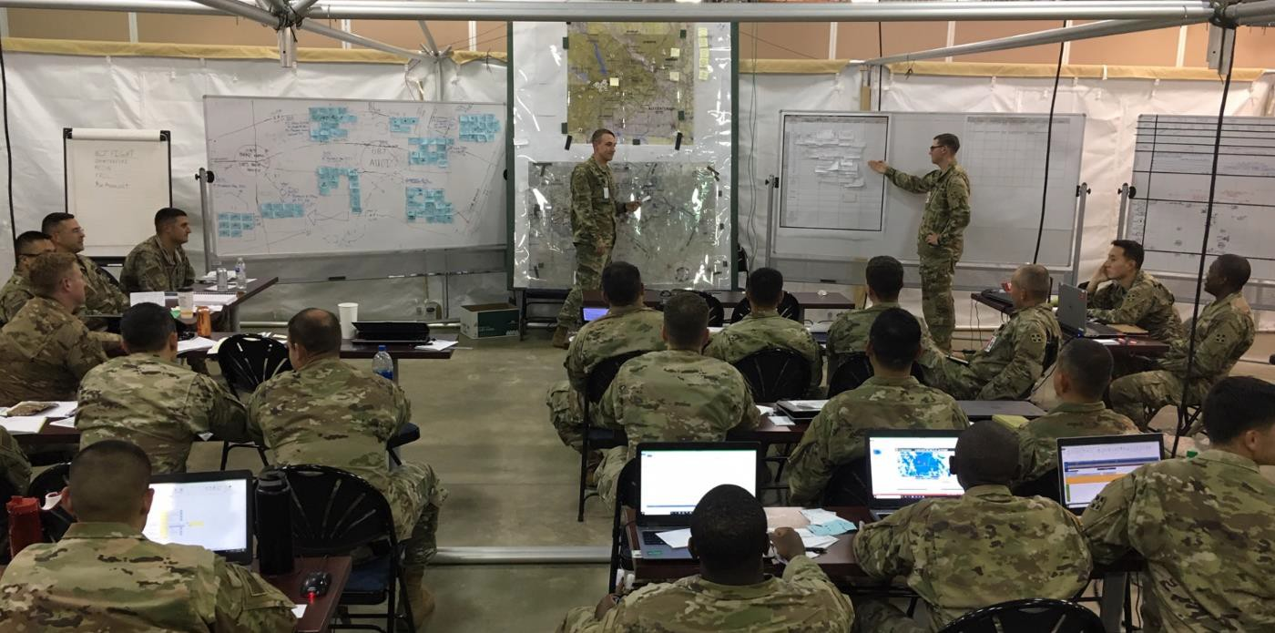
The War Game Room Set Up (TTP)
Concept Sketch
&
Statement
Large Map
(Upright, not flat)
Recorder
(Laptop with
Synch Matrix on digits)
Synch Matrix
(Hard Copy)
XO
S3 S2
PIR
BCT
Fights
ISB
Red Icons
Timeline
Blue Icons
TGT
Synch Mat
HPTL
DSM
Other Items to display / have on hand: Timeline (HOPE)
CCIR
Running Estimates
RFIs & Due Outs Recorder
Casualty Estimate Calculator Program
Combat Lost Charts
Info Manager
Order Production
(Base Order of Digits)
71

Slide 78
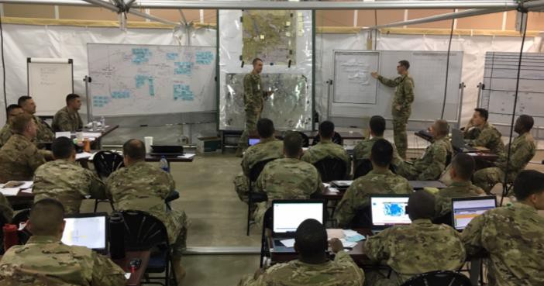
The War Game Process
The Room Set Up
LTP TTP
FM 6-0, Change 2
- XO: Briefs the Rules of Engagement for the war gaming.
S3: Defines all the Brigade Fights (turns) & Critical Events for each Brigade Fight to be discussed, i.e. Air Assault (Air Assault No Go), Action on OBJ DAGGER (MASSCAL), etc. using the Synch Matrix.
S3: Gives the location of all Brigade forces and their current actions using map and icons.
WfF Leads: Gives an update of any events that had occurred prior to start of war game date/time. Example: Division assets cleared routes, Div deep fires have fired TGT X, etc.
S2: Gives the enemy lay down using map and enemy icons.
* Don’t forget pertinent WFF leads assist the S2 with Reverse WFF throughout.
XO: Starts the war game “Action” with the time is now X, begins reading the left side of the Synch Matrix. FM 6-0: Actions are those events initiated by the side with the initiative.
Staff Rep: Gets up, moves their icon on the map, reads his Synch Cards out load to the group, begins the open dialogue.
XO/S3: Approves the information on each staff’s synch card.
Staff: Tapes the Synch Card to the Synch Matrix in the appropriate column and time and space and sits down.
XO: Identifies the next staff member to brief and moves forward.
*The process does not stop to wait for the recorder to type the Information onto the Synch Matrix!
Info Manager: Takes the Synch Matrix card and reads the card for content and readability, and then hands it to the recorder.
Recorder: Types in the information onto the synch matrix and places a check on the card to signify that it has been recorded and hands it back to the Info Manager.
Info Manager: Places the synch cards back on the synch matrix in the appropriate column and pulls the next card.
* Recorder/Info Manager: If the recorder has a question about the information on the card he hands the card to the Info Manager and the Info Manager walks over to coordinate with the staff member who owns the synch card. He does not stop the
Process! The recorder can move to the next card while coordination is occurring.
* During the coordination if changes were made to the Synch Card the Info Manager validates the correction and ensures the recorder has made the changes before placing the card back onto the Synch Matrix
- Repeat these steps until the war gaming is complete.
Recorder (Laptop with Synch Matrix on digits)
Staff Rep
Info Manager
Staff Info Card
Staff Section: S3
Unit: 2-22 IN
Phase: Phase III Assault on OBJ DAGGER
- DTG/Time: 12 0930 SEP 2018
Location/Grid: RP123456
Task: Clear enemy on OBJ DAGGER
Purpose: In order to allow the freedom of movement of the main effort onto OBJ HAMMER
Activity: N/A
- OPORD Recorder: Takes card from recorder and writes OPORD
72

Slide 79
How do you synch the events you don’t have time to war game?
Battlefield Framework | Shaping Operations |  | Shaping Operations |  |  | Decisive Operations |  | Decisive Operations
Event | C2 Air Assault |  | Critical Event: Air Assault “No Go” |  |  | Actions on OBJ BLADE |  | Critical Event: Commit the Reserve
Date/Time | Air Assault Begins: 070200JUN | Air Assault Complete 070400JUN | Truck Infil Begins 070400JUN | Truck Infil Ends 071600JUN |  | 2-22 Assault 080400JUN | 1-87 Assault 080800JUN | Planning Priority Reinforce 2-22 then 1-87 on OBJ BLADE
24 Hours Difference!
Q: How do we synchronize events that occur within those 24 hours when we don’t have enough time to war game those events?
Prior to War Gaming to XO informs the staff of the key events (turns) and critical events to be war gamed.
For the large gaps in time that the staff will not war game the staff needs to bring their assumptions, facts, tasks that will need to occur within those gaps that will be written in the order.
In between critical events during the war gaming, the staff needs to bring up their assumptions, facts, tasks, etc. that will occurred before or after this turn or before the next turn.
The XO will do his best to issue guidance, answer questions, inform staff sections that need to link up, etc. The staff then needs to conduct direct staff coordination after war gaming.
Those specified and coordinating tasks, not war gamed still need to be placed in the operations order.
S3: You will have to “reset” the icons on the map and brief the staff on what happen and where you are in space and time when jumping to the next event.
- WfF Leads need to brief the staff on any key events that have occurred, if applicable during the time period you are skipping over, i.e. FSO: any targets that have been fired, ENG: any routes that have been cleared, etc.
73

Slide 80
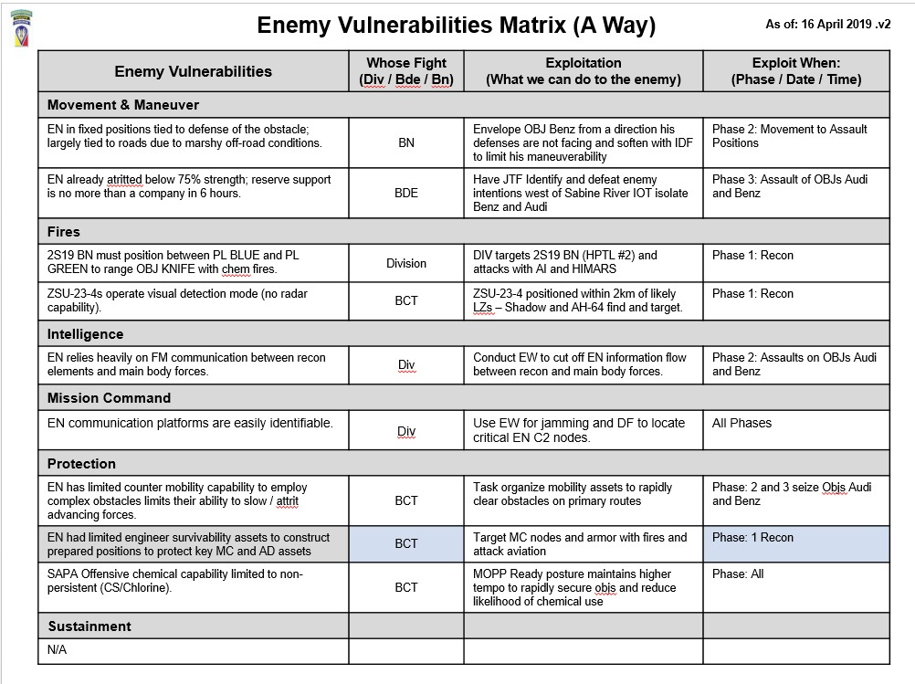
Enemy Vulnerabilities Matrix (TTP)
As of: 16 April 2019 .v2
Don’t forget to confirm during War Gaming did we address
all the enemy vulnerabilities we identified during Mission Analysis!
If we determined that a Enemy vulnerability was a Battalions responsibility to
address, did we at Brigade give them the right assets to address that vulnerability?
If we determined that a Enemy vulnerability was a Division responsibility to
address, did we at Brigade conduct the proper coordination with Division to ensure they agree to address
that vulnerability?
74

Slide 81
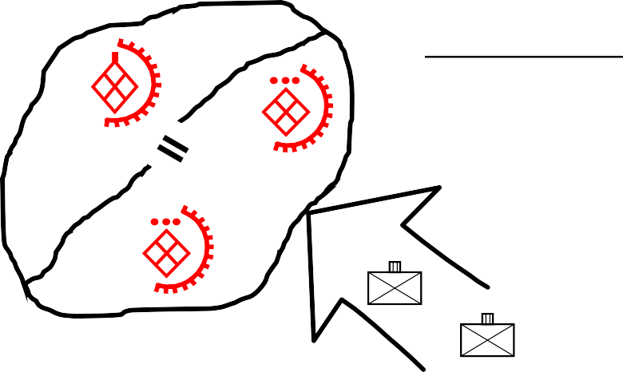
War Gaming Battle Casualty Estimate TTP
LTP Trends | Cost | Fix
No one on the staff uses a Battle Casualty Estimate Calculator during the MDMP War Gaming Step. | The XO, S3, and S2 pull radium casualty figures out of the air after each counter-action dialogue and the units medavac plan is not based on realistic casualty figures. Therefore their plan is not validated and or properly synchronized. | - Assign ownership of executing the battle casualty estimate calculator during war gaming to the BCT S1 with assistance from the MEDO and or Surgeon.
E X A M P L E
EN Force on OBJ AUDI
2 x Inf Companies
70% strength
In Hasty Defense
OBJ AUDI
Friendly Force is 1st Bn, 501st
Total Assigned: 575 pax
Total Assaulting the OBJ: 375 pax
1 501
Common Mistakes:
- S1/MEDO will input into the casualty calculator the units “assigned” strength. They should put into the system the number of troops actually “assaulting” the objective.
Common Mistakes:
- S1/MEDO will forget to calculate that the enemy is only at 70% strength and will put in a enemy assigned strength at 100%.
1
Situation: OBJ CHEVY is broken down into two sub-objectives (BMW & FORD). OBJ BMW has
two INF PLTs dug in and OBJ FORD has a INF CO dug in. 1-87 is assaulting OBJ BMW and 2-22 will pass through 1-87 and assault OBJ FORD.
Common Mistakes:
- S1/MEDO will input into the casualty calculator that 1-87 is going against all the enemy on OBJ CHEVY, when in reality they are only going against two INF PLTs on OBJ BMW. They will do the same for 2-22, when in reality 2-22 will pass through 1-87 and attacking only the enemy
OBJ CHEVY
E X A M P L E
OBJ FORD
OBJ BMW
company element on OBJ FORD.
2 22
1st Bn, 87th INF
Total Assigned: 440 Total AASLT OBJ: 300
1
87
2
1
87
2nd Bn, 22nd INF Total Assigned: 440
Total AASLT OBJ: 300
2
22
75

Slide 82
MDMP Step 5: COA Comparison

Slide 83
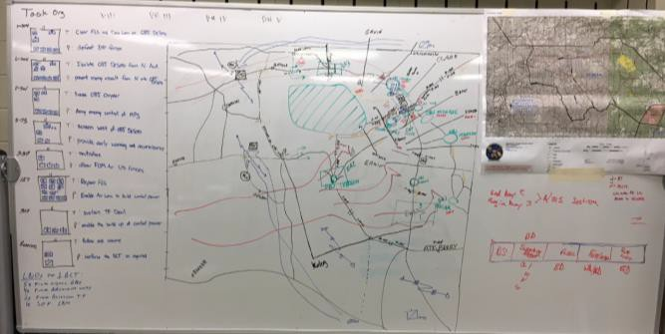
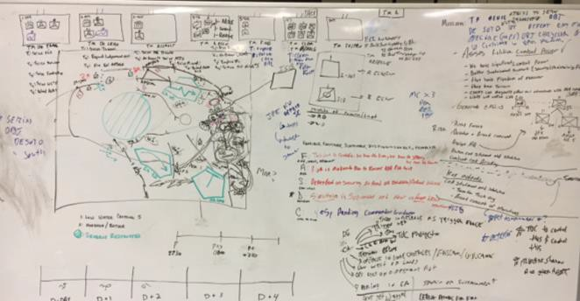
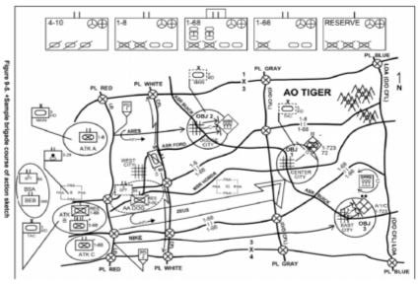
Step 5: COA Comparison
Units forget to develop or use the evaluation criteria developed during Mission Analysis.
Units do not use parallel formats to develop their courses of action, giving CDRs an
“apples to oranges” comparison.
COA 1 COA 2
Different Formats make it confusing for the Cdr to compare the COAs
versus
COA 1
COA 2

Slide 84
Step 6: COA Approval
- Units fail to complete the plan once the Cdr’s has approved the plan and or made modifications to the plan.
- If you develop two COAs or one COA the Cdr will either chose a hybrid of the two COAs or modify your one COA.
Team One Team Two
All Staff Members
COA 1
COA 2
COA 1
Commander’s Guidance
Commander’s Guidance
COA
1.5
COA 1.5
The staff needs to stop and complete the plan!
Most staffs go right into Step 7: Orders Production.
You have to brief both teams on the new COA.
You have to re-synch the changes based on the Commander's directive.
XOs fail to plan for this added step in their timeline.
78

Slide 85
MDMP Step 7:
Orders Production, Dissemination, and Transition
79

Slide 86
Step 7: Orders Production, Dissemination, and Transition
- Units lose focus on the production of the Cdr’s minimum OPORD / fighting products.
Ops Graphics
DSM
HPTL
Synch Matrix
Excheck
Fire Spt
Execution
Matrix
FM 6-0, p. 9-42. …during Step 7 the staff may conduct a more detailed war game of the selected COA to more fully synchronize the operation and complete the plan.
XO and S3 fail to allocate time to review the staff products or fail to divide up the work load.
Units fail to designate the “Arts & Crafts” section to produce the final order’s products and/or fail
to direct a best TTP for mass producing products.
80

Slide 87
Section III: Rehearsals
81

Slide 88
Developing the Plan for the Brigade’s Combined Arms Rehearsals (CAR)
LTP TTP
O/C-T Observed Trends | Cost | Fix
The BCT uses a detailed written “script” for their BCT CAR. | Bn Cdrs read from a script and do not explain “How” they are going to accomplish their mission. Bn Cdrs do not interact with other Bn Cdrs to understand the synchronization between the main & supporting efforts. | Delete the scripts and let the Bn Cdrs have a free flow discussion on “how” they will accomplish their mission. Build a agenda along with assigned critical event for each action to be rehearsed in order to provide the CAR structure and to keep it on time.
The XO & S3 leave out the S2 when developing the agenda and critical event. | The S2 comes un-prepared or the enemy action during the CAR is out of synch with the S2’s initial IPB and the friendly maneuver causing confusion. | At a minimum the XO, S3, and the S2 should build the CAR’s agenda and nest each critical event with the S2’s IPB products.
The staff fails to provide the BCT Cdr a recommended agenda / critical event for the CAR. | Staffs waste valuable time rehearsing less important events or run out of time before they get to BCTs decisive ops / critical events. | Provide the BCT Cdr a recommend CAR agenda with assigned critical event for approval in order to keep the CAR focused on the BCT fights and prevent last minute “good ideas.”
Rehearsals are not focused on the BCT Fights. | BCTs waste time rehearsing a Bn and or a Co level event rather than focusing on BCT level actions or even the decisive operation. | The CAR events should be nested with the same events / activities that the BCT war gamed.
Definitions (non-doctrinal):
Agenda: A list of the main events / actions that will be address during the (CAR). These should be nested with the BCT Fights!
Critical Event: Scenarios that include enemy actions, U.S. reactions, or synch / battle drills, etc. the CAR intends to address.
Below is an example of nesting a CAR’s agenda events with an assigned critical events.
Agenda *Focused on BCT Fights | Recon Fight | Air Assault | Actions on OBJ DAGGER | Expand Lodgment | Rear Area
Critical Event | Cav entry operations MASCAL | Situation to cause a shift to Alter LZ | Battle Handover from 2-22 Bn to 1-87 Bn | Clearance of Fires during FPOL | Chem Strike in the BSA
Planning Considerations:
The CAR planning team should war game out the worst case scenarios when developing the agenda and critical events. Remember most units only have around two hours to complete their CAR while in the maneuver area at JRTC!
Examples:
IAW the S2’s most likely COA, i.e. Chem Strike in the BCT rear area.
Air assault is cancelled due to weather or must shift to alternate LZs.
Recon elements first enter the maneuver area and take MASCAL while they BCT is still in ISB.
82

Slide 89
Developing the Plan for the Brigade’s Combined Arms Rehearsals (CAR)
LTP TTP
Combined Arms Rehearsal (CAR) Agenda
Ground Rules for CAR: (XO)
Speakers Format: Unit, Time, Task, Purpose, Activity, Method (the How) Reports
Commander’s Opening Remarks: (CDR)
Map / Terrain Board Orientation: (S3)
1. Shaping Operation: Reconnaissance Fight: (Cav only element forward of LD)
Critical Event: MASCAL
- Time is : (S3) *Use the Synch Matrix for the Recon Fights start and end times
- Intel Collection Plan: (S2 or ICM)
Concept of Fires: (FSO)
Joint Fires (JTAC)
Air Picture (BAO)
Enemy Situation after Shaping (BDA): (S2) Talks specifically to the enemy situation during the Recon Fight.
Bns Concept for this phase: Briefing Order: 2-25 Avn, 2-14 CAV, 2-11 FA, others.
Inject Critical Event: S3 walks unit through MASCAL has just occurred…what are your actions? Briefing Order: 2-14 CAV, 2-25 AVN, MEDO, Bde S4, others….
Decision Points: S3
2. Decisive Operations: Seizure of OBJs DAGGER
Critical Event: Chemical Strike
Time is : (S3) *Use the Synch Matrix for actions on OBJ DAGGER start and end times
Intel Collection Plan: (S2)
Concept of Fires: (FSO)
Joint Fires (JTAC)
Air Picture (BAO)
Enemy Situation after Shaping (BDA): (S2) Talks specifically to the enemy situation on OBJ DAGGER.
Bns Concept for this phase: Briefing Order: 2-22INF, 2-25 AVN, others….
Inject Critical Event: S3 walks unit through Chem strike has just occurred…what are your
actions? Briefing Order:2-22INF, 2-25 AVN, MEDO, Bde S4, others….
Decision Points: S3
3. Decisive Operations: Battle handover on OBJ KNIFE (2 x Bns on same OBJ)
Critical Event: Clearance of Fires
Time is: (S3) *Use the Synch Matrix for the OBJ KNIFE start and end times
Intel Collection Plan: (S2)
Concept of Fires: (FSO)
Joint Fires (JTAC)
Air Picture (BAO)
Enemy Situation After Shaping (BDA): (S2) Talks specifically to the enemy situation on OBJ KNIFE.
Bns Concept for this phase: Briefing Order: 2-22INF, 1-87INF, 2-25 Avn, others…
- Inject Critical Event: S3 walks unit through you just received 5 x rounds if indirect fire, what are your actions? Briefing Order: 2-22INF, 1-87INF, 2-25 AVN, FSO, others….
- Decision Points: S3
Key items to consider:
- Staffs should issue the agenda and critical event with Warning Order #3 in order to give subordinate Cdr’s and staffs time to prepare.
CAR Facilitator: The CAR is also a rehearsal for the S3 and S2 to ensure they understand the overall scheme of maneuver before they push forward in the BCT TAC. Too many times we see the XO try to dominate the CAR leaving the S3/S2 on the side lines.
Generic Time Planning Factors:
Introduction, CAR ROE, orientation to the terrain model: 10 to15 minutes.
Complete discussion on just 1 x agenda event along with its 1 x assigned critical event: 20 to 25 minutes.
Closing guidance, review of due outs, etc: 10 to 15 minutes Summary: Intro/orientation + 5 agenda events w/ nested critical events + closing comments/review due outs = 1 hour 40 minutes (+)
SOP should outline the minimum speaking requirements for each Bn Cdr or his representative when they stand to speak:
Example: Unit, Time, Task, Purpose, Activity, Method (how), Reports
Who will actually stand on the sand table and talk.
COA1: Bn Cdr’s sit on the side line and their Bn S3s are on the sand table talking w/ A/S3 moving icons.
COA 2: Bn Cdrs are on the sand table talking and their Bn S3s are moving the icons.
* We have observed units have a better professional discussion when the Bn Cdr’s are actually up on the sand table explaining the “how” they will accomplish their mission and their Bn S3s moving their icons.
- Review Due Outs: Units fail to either review the rehearsal due outs at the completion of the CAR or fail to assign a seasoned officer as the note taker.
Review Due Outs: (A/S3)
Alibis by Staff
Closing Comments: Bn Cdrs, BCT CSM, BCT Cdr
83

Slide 90
Developing the Plan for the Brigade’s Combined Arms Rehearsals (CAR)
Review Due Outs: (A/S3)
Alibis by Staff
Closing Comments: Bn Cdrs, BCT CSM, BCT Cdr
3. Decisive Operations: Battle handover on OBJ KNIFE (2 x Bns on same OBJ) Critical Event: Clearance of Fires
Time is: (S3) *Use the Synch Matrix for the OBJ KNIFE start and end times
Intel Collection Plan: (S2)
Concept of Fires: (FSO)
Joint Fires (JTAC)
Air Picture (BAO)
Enemy Situation After Shaping (BDA): (S2) Talks specifically to the enemy situation on OBJ KNIFE.
Bns Concept for this phase: Briefing Order: 2-22INF, 1-87INF, 2-25 Avn, others…
- Inject Critical Event: S3 walks unit through you just received 5 x rounds if indirect fire, what are your actions? Briefing Order: 2-22INF, 1-87INF, 2-25 AVN, FSO, others….
- Decision Points: S3
Decisive Operations: Seizure of OBJs DAGGER Critical Event: Chemical Strike
Time is : (S3) *Use the Synch Matrix for actions on OBJ DAGGER start and end times
Intel Collection Plan: (S2)
Concept of Fires: (FSO)
Joint Fires (JTAC)
Air Picture (BAO)
Enemy Situation after Shaping (BDA): (S2) Talks specifically to the enemy situation on OBJ DAGGER.
Bns Concept for this phase: Briefing Order: 2-22INF, 2-25 AVN, others….
Inject Critical Event: S3 walks unit through Chem strike has just occurred…what are your actions? Briefing Order:2-22INF, 2-25 AVN, MEDO, Bde S4, others….
Decision Points: S3
- Decision Points: S3
are your actions?
1. Shaping Operation: Reconnaissance Fight: (Cav only element forward of LD) Critical Event: MASCAL
- Time is : (S3) *Use the Synch Matrix for the Recon Fights start and end times
- Intel Collection Plan: (S2 or ICM)
Concept of Fires: (FSO)
Joint Fires (JTAC)
Air Picture (BAO)
Enemy Situation after Shaping (BDA): (S2) Talks specifically to the enemy situation during the Recon Fight.
Bns Concept for this phase: Briefing Order: 2-25 Avn, 2-14 CAV, 2-11 FA, others.
Inject Critical Event: S3 walks unit through MASCAL has just occurred…what
Ground Rules for CAR: (XO)
Speakers Format: Unit, Time, Task, Purpose, Activity, Method (the How) Reports
Commander’s Opening Remarks: (CDR)
Map / Terrain Board Orientation: (S3)
Briefing Order: 2-14 CAV, 2-25 AVN, MEDO, Bde S4, others….
Combined Arms Rehearsal (CAR) Agenda
84

Slide 91
Fires & Intel Rehearsal
Page 1
Page 2
85

Slide 92
Mission Command Rehearsal
Page 1
Page 2
86

Slide 93
Sustainment Rehearsal (A Way)
Page 1
Page 2
87

Slide 94
Section IV: Other TTPs
88

Slide 95
Liaison Officer Duties and Responsibilities
LNO Functions Monitor: Monitor the operations of both the receiving and sending organizations, and understand how each affects the other. Coordinate: Synchronize current operations and future plans between the parent organization and the receiving organization. Advise: Advise the receiving commander and staff on the capabilities of the represented command. Assist: Attend meetings and planning sessions, to affect informed decisions concerning represented command
LNOs are not: Full time planners for the receiving organization Watch Officers for the receiving organization A substitute for sending critical information through normal channels A replacement for proper staff-to-staff coordination A replacement for augmentees or representatives
Parent Unit provides to LNO: | LNO provides to receiving organization: | Receiving organization provides to LNO:
1. Initial briefings and updates on operations, status | 1. Unit mission, task org, capabilities, and limitations of parent unit. | 1. Work area within or near the CP.
2. Transportation, Computer, Weapon, equipment. | 2. Boundaries changes and effective times. | 2. Logistical support.
4. Current graphics. | 4. Combat power status. | 4. Access to all relevant meetings and briefings
5. Current OPORD/FRAGO | 5. Intelligence update. | 5. A sleeping and rest area near the CP.
6. Most recent Commander's SITREP. | 6. Completed plans. | 6. Unit SOPs and recent, pertinent command directives.
7. CL I, III, & V for the initial 48-hours of operations. | 7. Status of planning. | 7. CL I, III & V after initial 48 hours of operations.
8. SOPs. | 8. Communications links with the parent unit. | 8. Access to office automatic equipment.
LNO Functions during MDMP
Receipt of Mission.
Alert unit to upcoming operation, communicate CDR’s Initial guidance and timeline
Update running estimate on status/capabilities of parent unit
2.
Mission Analysis.
Communicate capabilities/limitations to the staff
Build understanding of enemy situation and upcoming mission requirements
Inform and provide parent unit; M.A. outputs and Cdr guidance
3.
COA Development.
Recommend appropriate task/purpose, command/support
relationships to employ the unit in each COA
Provide insight on unit organization, employment, capabilities/limitations
Explain if proposed requirements exceed unit capabilities
Develop understanding and inform unit of upcoming mission requirements
4.
COA Analysis.
Serve as the parent unit during the wargame
Further develop visualization of the operation, conditions and resources required for success
Identify coordination needed to produce synchronized results
5.
COA Comparison.
Participate/observe comparison sessions and briefing
6.
COA Approval
Develop understanding of Cdr decision and inform unit of upcoming mission requirements
7.
Orders Production
Assist in dissemination of orders and graphics to the unit
Receive, staff, and assist the staffs in answering RFIs
References: FM 6-0 CDR and Staff Organization and Operations, CH 13 (May 2014); CALL Commander and Staff Guide to Liaison Functions DEC 2019; ALASC, JTF Liaison Handbook (AUG 1998)
89

Slide 96
BCT HPT Strike Battle Drill “TTP”
Pre-Strike Actions: Target determined and planned during BCT targeting process. BCT Fires Cell plans target at expected location and BCT Staff sets conditions for successful attack.
Fires Cell | ADAM/BAE | Battle CPT | CDE Team (TO, BJA, S2 CUOPS)
Plan TGT on TLWS and pass to Div FC, D/A, FA BN Submit DD-1972 for CAS and EAB ISR support Coord with D/A (or R/GSR Firing Unit) to compute firing data (F/U location, HIMARS flight path, max ord, time of flight, etc.) | Submit appropriate ACMs (ACA, air corridor, etc.) for input in ACO Ensure ACMs published to all airspace users in the BCT AO | Provide planning dimensions for POI ROZ, POI grid, expected TOT, and 0.1% PI distance for engagement plan | Compute initial CDE assessment during collection efforts Identify likely routes of ingress/egress where collateral concerns could emerge at TGT location Pre-brief approval authority based on anticipated CDE level
Strike Actions: HPT identified by ISR. S2 CUOPS alerts CUOPS Staff of HPT. Battle CPT initiates Strike Battle Drill. Actions by Staff occur simultaneously. Strike approval granted by the appropriate authority based on CDE level.
Fires Cell | ADAM/BAE | Battle CPT | CDE Team (TO, BJA, S2 CUOPS)
Initial CFF to appropriate attack asset (FA BN, D/A, R/GSR FA BN, CAS) as “At My Command” mission Receive MTO for attack system, pass to Battle CPT for dissemination Receive redcon status from attack asset Issue “Fire” command to attack assets when mission cleared and approved | Activate appropriate ACMs and inform airspace users Verify airspace users not violating ACMs | Notify ISR/Ground units of timeline for attack Verify ISR/Ground units location is clear of target | Initial collateral concern scans with ISR assets Confirm CDE level of target based on identified collateral concerns Receive strike approval from appropriate authority
90

Slide 97
Military Decision Making Process Fires Inputs/Outputs
FIRES OUTPUT w/ WARNO #2
FSCOORD/BDE FSO send to FA BN
& MNVR Fire Cells in WARNO #2 FSTs v1, TLWS v1, FSEM v1, HPTL v1, AGM v1, TSS v1, RDO v1
FIRES OUTPUT
after COA DEV
BCT FC send to FA BN & MNVR FC independent of BCT Staff
− FST v2 - TLWS v2
− FSEM v2 - FSCM V1
− Schedule of Fires - RDO v2
− HPTL/AGM/TSS/ TSM v2
OUTPUT
- WARNO #3:Commander approved COA, Refined commander’s intent, CCIRs, EEFIs
FSCOORD/BDE FSO
publishes to FA BN and MNVR Fires Cells with WO#3
− FSTs Version 3
− Scheme of Fires Version 3
− TLWS Version 3
− FSEM Version 3
− HPTL/AGM/ TSS/TSM
− FSCM Version 3
− RDO Version 3
INPUT
- Mission
Received or Analyzed
OUTPUT
WARNO #1
Commander’s Guidance
OUTPUT
- WARNO #2: Mission
Statement, Cdr’s Intent, Planning guidance, Initial CCIR & EEFI, Updated IPB
STEP 1
Receipt of
Mission
STEP 2
Mission Analysis
FSO leaves with developed / CDR approved
FSTs v1,HPTL v1, TLWS v1, AGM v1,
TSM v1, RDO V1,
FS Asset Status; FS Capes/Limits OBS Platforms avail.
Receive CDR’s
Guidance for fires
STEP 3
COA
Development
STEP 4
COA Analysis (Wargame)
STEP 5
COA
Comparison
STEP 6
COA
Approval
STEP 7
Orders Production
STEP 1: Analyze higher order
STEP 2: Conduct Initial IPB
FSO:
Define OE Identify AO/AI
Build MCOO with S2
MISSION ANALYSIS
COA DEVELOPMENT
FSCOORD/BCT FSO WARGAME ACTIONS
(per Phase or sub-Phase as required)
FSCOORD/BCT FSO COA COMPARISON & APPROVAL
Analyze the battlefield effects of terrain and roads on enemy
Higher HQ’s Order Analysis
Determine what FSTs are tasked to your unit from higher Annex D.
Display FSCMs in AO and report impact
Analyze HPTs that are present in or effect your AO
List EAB assets available for request
List EAB allocated to your unit
Understand ROE, Restrictions, Constraints
Provide FS input to IPB
Display Enemy likely PAAs/POOs
Impact of terrain and weather on Fires WfF (Friendly & Enemy)
Analyze the state of FS running estimates
Determine ammunition requirements for each FST
Create FS Asset range arc depiction and estimated Low Angle MAX ORD
Depict anticipated GTL from proposed PAAs to OBJs or Engagement Areas
Determine specified, implied and essential tasks
Determine Fire Support Task & Purpose
Develop High Payoff Target List for BCT CDR (nest this effort with the BCT/BN Targeting Cycle & Collection Plan)
Identify ISR support requirements by type to locate each High Payoff Target
Provide input into NAI/TAI development
Provide input into CCIR/EEFI development
Determine FSCMs
Ensure the FS Rehearsal is listed in the Planning Timeline
Produce & disseminate Version 1 of FSTs HPTL, TLWS, AGM, TSM, RDO, FSCM
Array Forces RADAR/Artillery
Display enemy IDF Range Arcs for both artillery & mortars
Display friendly (Organic & EAB) artillery and mortar range arcs w/ MAX ORD per charge and range
Identify PAAs (primary & alternate) for each phase
Identify radar positions for Q53/36 & Q50s Produce & Disseminate to FA BN & BN Fires Cells for each COA
FSTs Version 2
HPTL Version 2
AGM Version 2
TSM Version 2
TLWS Version 2
FSEM Version 2
FSCM Version 2
FS Overlay Version 2
RDO Version 2
** Include Target Refinement Cut-off time
1. Review the Purpose & Location of:
- Graphic Control Measures
FSCMs (CFL, NFA, RFA)
ACMs (CA, CL, ROZs, IPs, FAH)
BCT & EAB Collection Assets
BCT & EAB FA assets
Radars
1. Compare each COA against the execution of & risk of failure to:
Collection & Attack of the BCT CDR’s HPTL
Execute air-to-surface & surface- to-surface fires simultaneously
Rapidly clear air & ground for Joint and Army fires
Execute Counterfire
Mass fires
Integration of EW Attack &
Plot template ENY IDF
positions
Identifies ENY Target
Acquisition
Identifies ENY IDF Trends Nominate NAIs/TAIs into
Targeting Process
2. Fire Support Task: execute each Target from TLWS in sequence with mnvr plan to validiate sensor-to-shooter
Nominate ISR and RADAR zones
- Verify the required Fire Order needed per Target per
FA BN:
ID Potential PAAs
STEP 3: Determine Specified
and Implied Tasks STEP 4: Review Available Assets
Update Running Estimates
STEP 5: Determine Constraints
STEP 6: ID Critical Facts &
Assumptions STEP 7: Conduct Risk Assessment
STEP 8: Determine Initial CCIR
STEP 9: Determine Initial Recon
Annex (R&S Plan) STEP 10: Plan Use of Time STEP 11: Write Restated Mission STEP 12: Conduct Mission Analysis
desired effect in JMEMs. Communicate the Fire Order to the ^{Collection}
- Ability to execute all targets with the appropriate munition/quantity on the Attack Guidance Matrix
FA Battalion for ammunition planning
3. Identify Air-Ground Integration Requirements/Conflicts for all Targets, OBJs, Engagement Areas
- Determine locations of all PAAs & MFPs excluding
handheld 60mm mortars
2. Complete FS Products for distribution in WARNO #3. IF THE
- Calculate GTL & MAX ORD for every target & Call For Fire ^{BCT DOES NOT DISTRIBUTE A}
Zone
Atk Aviation Routes, Contact Points, & Atk By Fire Positions (ABF), Battle Positions (BP)
Recommend/Mandate specific IPs,/ Stay Above Alititudes/Final Attack Headings for CAS
UAS Transit Routes & ROZs deconflicted with RW & CAS
4. Verify Radar Zones support responsive Counterfire (CFFZ) & protection of critical assets (CFZ & CZ)
WARNO #3, THEN THE BCT FIRES CELL MUST DISTRIBUTE THE ANNEX D UPON COA APPROVAL
Develop Acquisition & RDO
Maintenance Plan
Queuing Schedule
Radar Zones
EAB/Joint Fires Intel Collection
Coordinate with the Collection Manager to synch the Intel Collection Plan-to-NAIs-to-HPTs by target type, collection platform & time
Assist the Collection Manager with requesting EAB collection assets ISO HPT engagement
Request & confirm EAB Army & Joint Fires Assets per ATO Cycle
Coordinate with ADAM/BAE to synch FS Plan w/ the Airspace Control Plan by phase & ATO Sustainment
Ammunition Available per phase
5. Ensure Target Synch Matrix is integrated with the scheme of mnvr & BCT Collection Plan
Verify the BCT Intell Collection Plan (Collection Manager) pairs the HPTs-NAIs-Sensor (collection platform)-Shooter over time per phase
Ensure the appropriate SHOOTERs (Arty, CAS, AVN, EW) are available over time per phase
Confirm submission & approval/disapproval of EAB Collection & Fires Platforms
Brief
STEP 13: Approve Restated
Mission
STEP 14: Develop Initial CDR’s
Issue CDR’s Guidance
STEP 16: Issue WARNO
STEP 17: Review Facts &
Assumptions
Intent
STEP 15:
91

Slide 98
Example of Network Transition from Analog to Digital
Airborne Assault Defend
BDE/BN
Alert, Marshal, Deploy Expand of Lodgment
PHASE I
PHASE II
PHASE III PHASE IV
D+2 D+4
BDE TAC
ISB OPERATIONS
P-HOUR
P+4
D+1
D+6
MC CAPABILITIES
FM TACSAT TRANSVERSE
BFT/JCR EMAIL/SVOIP
PORTAL
ADOBE CONNECT
BDE/BN TOC FOC
JNN/CPN AIR LANDED
GRIPPS
SHARK
AIR/LAND VEH
GATR
CPOF AFATDS AMDWS
TAIS ADSI DCGS-A
TIGR BCS3 MC4
ISB
GATR
AFATDS VEH / FM
ABCS SYSTEMS
GRIPPS
GATR
AMDWS VEH & SENTINEL RADAR
P+1
P+4
D+4
D+5
CP/TOC IOC / SERVER TRANSITION
ISB (BDE MAIN)
ALL MC & ABCS SYSTEMS OPERATIONAL
CP/TOC FOC / FULL DIGITAL
HIGHER
P: TRANSVERSE
A: CPOF w/VENTRILLO C: FM (JTF-21)
E: TACSAT (JTF-21) E1: IRIDIUM
P: FM (JTF-21)
A: TACSAT (JTF-21) C: BFT/JCR
E: IRIDIUM
P: EMAIL/EXCH A: TRANSVERSE C: SVOIP
E: IRIDIUM E1: BFT/JCR
P: TRANSVERSE
A: CPOF w/VENTRILLO C: FM (FH)
E: TACSAT E1: IRIDIUM
PACE
LOWER
P: EMAIL/EXCH A: SVOIP
C: FM (CMD)
E: TACSAT (CMD)
P: TRANSVERSE A: FM (CMD)
C: TACSAT (CMD)
E: BFT/JCR
P: TRANSVERSE (GRRIPS) A: FM (CMD)
C: TACSAT (CMD) E: IRIDIUM
P: TRANSVERSE A: EMAIL/EXCH C: FM (CMD)
E: TACSAT (CMD)
92

Slide 99
Army Support Relationships
References:
ADRP 5-0 Chapter 2
FM 6-0 (Chg 2), Annex B
If relationship with: | Then inherent responsibilities:
 | Have command relationship with: | May be task organized by: | Unless Modified, ADCON responsibility goes thru: | Are assigned position or AO by: | Provide liaison to: | Establish/mai ntain commo with: | Have priorities established by: | Can impose on gained unit further Cmd or Spt relationship of:
Direct Support | Parent unit | Parent unit | Parent unit | Supported unit | Supported unit | Parent unit; Supported unit | Supported unit | See note 1
Reinforcing | Parent unit | Parent unit | Parent unit | Reinforced unit | Reinforced unit | Parent unit; reinforced unit | Reinforced unit; then parent unit | N/A
General Support- reinforcing | Parent unit | Parent unit | Parent unit | Parent unit | Reinforced unit and as required by parent unit | Reinforced unit and as required by parent unit | Parent unit; then reinforced unit | N/A
General Support | Parent unit | Parent unit | Parent unit | Parent unit | As required by parent unit | As required by parent unit | Parent unit | N/A
Note1: Commanders of units in direct support may further assign support relationships between their subordinate units and elements of the supported unit after coordination with the supported commander.
Bottom Line: If LOG Planners fail to understand the Support Relationships outlined in FM 6-0, C2
Annex B they will fail to adequately plan for LOG resupply and thus the BCT mission could fail.
93

Slide 100
Army Command Relationships |  |  |  |  |  |  | References: ADRP 5-0 Chapter 2 FM 6-0 (Chg 2), Annex B
If relationship with: | Then inherent responsibilities:
 | Have command relationship with: | May be task organized by: | Unless Modified, ADCON responsibility goes thru: | Are assigned position or AO by: | Provide liaison to: | Establish/mainta in commo with: |  | Have priorities established by: | Can impose on gained unit further Cmd or Spt relationship of:
Organic | All organic forces organized with the HQ | Organic HQ | Army HQ specified in organizing document | Organic HQ | N/A | N/A |  | Organic HQ | Attached; OPCON; TACON; GS; GSR; R; DS
Assigned | Gaining Unit | Gaining HQ | Gaining Army HQ | OPCON Chain of Cmd | As required by OPCON | As required by OPCON |  | ASCC or Service assigned HQ | As required by OPCON HQ
Attached | Gaining Unit | Gaining Unit | Gaining Army HQ | Gaining Unit | As required by gaining unit | Unit to which attached |  | Gaining unit | Attached; OPCON; TACON; GS; GSR; R; DS
OPCON | Gaining Unit | Parent unit and gaining unit; gaining unit may pass OPCON to lower HQ | Parent unit | Gaining Unit | As required by gaining unit | As required by gaining unit and parent unit |  | Gaining unit | OPCON; TACON; GS; GSR; R; DS
TACON | Gaining Unit | Parent unit | Parent unit | Gaining Unit | As required by gaining unit | As required by gaining unit and parent unit |  | Gaining unit | TACON; GS; GSR; R; DS
Note: In NATO, the gaining unit may not Task Org a multinational force. (See TACON) ADCON administrative control HQ headquarters AO area of operations N/A not applicable ASCC Army Service component command NATO North Atlantic Treaty Org DS direct support OPCON operational control GS general support R reinforcing GSR general support-reinforcing TACON tactical control
94

Slide 101
Section V:
Air Assault Planning
95

Slide 102
Maneuver WfF: Air Assault
FM 3-99, Mar 15
FM 3-04, Jul 15
 | Figure 9-1. Air assault planning stages
Air Assaults are not the same as an Air Movements: Air Assaults consist of the following:
Total integration of available firepower & maneuver.
It’s a temporary group of forces for a specific mission.
Under the control of a single commander / HQs.
Precisely planned and vigorously executed.
To seize and hold key terrain or rapidly destroy enemy forces.
It allows Commander to:
Strike over extended distances and terrain barriers.
Attack the enemy when / where most vulnerable.
Figure 8-3. Example of air assault leadership positioning
96

Slide 103
Air Assault Trends
PZ Operations:
BCT Staffs do not plan for C2 of PZ operations:
Hvy / Lt PZ Ops
Sling load Operations
Chalk Escorts
Execute bump plans
CASEVAC returning casualties
* LTP recommends tasking a BN (BSB)
Ground Tactical Plan:
BCT Staffs fail to start planning with the “Ground Tactical Plan” and then work backwards through all the steps back to Staging plan.
Figure 9-1. Air assault planning stages
BCT Staffs do not plan SEAD fires in detail:
Task and purpose of targets
Observer plan and triggers
Timing / schedule of fires
Unobserved fires vs PID (DATE vs COIN)
Ground Tactical Plan:
BCT S3s fail to identify the minimum force required for each objective. This helps the Cdr to determine options if a certain air craft are delayed, diverted, aborted, or shot down.
97

Slide 104
Air Assault Planning Considerations
Initial Planning Conference (IPC)
Conducted at the AATF HQs
1st Meeting between the AATF’s staff & supporting Avn unit
- Avn unit brings the: AMC, LNO, Avn S-2 & S-3, Flight Leads
- Addresses environmental factors that impact the mission: Climate, Weather, Terrain, Altitude
24/48/72 Hour Air Assault Mission Planning mirrors the MDMP steps. See Feb 2019 Gold Book
Staff Responsibilities:
IPC: AATF S3 / BAO; Avn Bn S3, AMC, LNO, S-2 & S-3, Flight Leads
AMCM – Chaired by AATF S3; ran by the BAO / Avn Planner
IPC Trends:
IPC not conducted early in the MDMP Process
COA is not approved prior to AMCM
Subordinate S3s don’t come to AMCM with 80-90% solution
Minimum Force Not Established
Bottom Line: Conduct the Initial Planning Conference (IPC) early– treat it like Warning Order #1; Make sure Subordinate S3s have time after COA approval to come to the AMCM with a 80-90% solution.
Air Mission Coordination Meeting (AMCM)
- Follows the development of the Ground Tactical Plan and/or the Course of Action
Chaired by: the AATF S3
Scheduled to allow Sufficient time for Maneuver units to decide on a specific Course of Action
AATFC approves COA before AMCM
Subordinate S3s must come to AMCM w/80-90% solution
S3, XO, or Cdr must approve any changes after AMCM
AMCM Products are:
Air Movement Plan
Landing Plan
Pickup Zones
Landing Zones
Minimum Force Required
Air Mission Brief (AMB)
Written product and the briefing itself
Is a Back-Brief to the AATFC
Slightest change can significantly affect plan
AATFC must approve any changes to the AMB
Products Are:
Air Movement Table - Communication Cards
PZ and LZ Diagrams - Operations Sketch
Route Cards - Execution Checklist
Figure 9-2. MDMP and air assault planning process
98

Slide 105
Air Assault Abort Criteria Matrix TTP
99

